Slide 1
Session ID & Cookie Security
of Web Applications
BY:
VIGNESH S

Slide 2
Agenda
What are Sessions & Cookies?
Session IDs & Their Role
Cookie Security Attributes
Common Attacks
Best Practices
POC of session hijacking
DVWA
Owasp juice shop

Slide 3
What is session and cookies?
SESSION
A session is information stored on the server to keep track of the user while they browse.
Since HTTP is stateless, the server does not remember users between page loads, so a session is used to identify and track the logged-in user.
How It Work
When a user logs in, the server creates a Session ID
The Session ID is stored on the user's browser (usually in a cookie)
Every time a new request is made, the Session ID tells the server which user is active

Slide 4
The session ends when:
User logs out
Browser closes (in most cases)
Session times out
What is stored in Session?
User authentication state
User profile or preferences
Temporary activity data
Where is it stored?
On the server - more secure than storing on browser
Session - Secure data stored on the server to identify the user

Slide 5
COOKIES
A cookie is a small piece of data that a website stores in your browser to remember you.
Why are Cookies used?
To store Session ID
To remember user preferences (theme, language)
Keep users logged in (persistent cookies)
Track user behavior (analytics)
Types of Cookies
Session Cookies - Removed when browser closed
Persistent Cookies - Stay until expired

Slide 6
Secure Cookies - Only sent over HTTPS
HttpOnly Cookies - Protected from JavaScript access
Where is it stored?
Inside the browser
Cookie - Small data stored in client browser to remember user information

Slide 7
Abstract
Damn Vulnerable Web Application (DVWA)
DVWA is an intentionally insecure web application used to practice real-world security attacks. In this project, Session Hijacking was tested to understand how attackers can steal or misuse session cookies to gain unauthorized access. By analyzing session IDs, manipulating cookies, and testing different security levels, we learned how poor session management can be exploited and how protections like secure cookie flags and session regeneration can prevent such attacks.

Slide 8
OWASP Juice Shop
This project demonstrates how insecure session management in web applications can be exploited to hijack user sessions. By capturing and reusing session cookies, an attacker can impersonate legitimate users, highlighting the risks associated with weak session handling. The exercise emphasizes the importance of secure session practices to protect sensitive user information.
The goal of the research is to determine whether the website in question is susceptible and whether its session IDs and cookies have been made public.
The study examines strategies used to hijack sessions, giving the knowledge needed to defend their platforms from these kinds of attacks. Knowing these techniques will help us put strong security measures in place to protect user information and enhance the user experience as a whole.

Slide 9
Objective
The objective of this study is to identify the vulnerabilities in a website called dvwa,owasp juice shop and is examined through Burp Suite, a well-known application for web application penetration testing.
The main focus is determining how attackers can exploit this vulnerability to steal user's session IDs and gain unlawful access to accounts.
Target and Scope: It specifically targets sensitive aspects of the dvwa,owasp juice shop website, such as account management, login, and other areas.
Suggestions: The study's specific goal is to establish areas of weakness and potential countermeasures that lower the likelihood of session hijacking.
Some ways that can be recommended are setting browser security preferences, using secure connections, setting a good password or using multi-factor passwords, monitoring account activities regularly, constantly updating the software, and using WPA/WPA2-protected Wi-Fi carefully.

Slide 10
Methodology & Tools
Scope & Assumptions
Targets: Local instances of OWASP Juice Shop and DVWA running inside a Kali Linux VM on VMware.
Tests limited to lab environment only — no external/third-party systems
Focus areas: cookie attributes and lifecycle, session generation and rotation, session invalidation, and indicators of session hijacking risk.
Reconnaissance (Passive): Use browser DevTools and curl to inspect HTTP(S) responses, Set-Cookie headers, Referrer/Origin behavior, and any token leakage in pages or URLs. Record cookie names, attributes (HttpOnly, Secure, SameSite, Domain, Path, Expires/Max-Age) and storage locations (cookies vs. localStorage).

Slide 11
Controlled Active Testing (Non-destructive): In the isolated lab, perform minimal, authorized interactions to trigger session creation, logout, login, and privilege changes to observe session lifecycle behavior (creation, regeneration, invalidation). Do not attempt exploits against real targets.
Analysis: Compare observations against best practices (secure cookie flags, session regeneration on auth, non-persistence of tokens in URLs or localStorage, entropy/length expectations). Document anomalies and their severity.
Validation of Mitigations: After applying a defensive configuration (e.g., enabling HttpOnly/Secure), re-run the same passive checks to confirm mitigations are effective.
Evidence & Reportingo Captured screenshots of browser DevTools (Network / Application → Cookies), curl -I outputs, and proxy captures (with sensitive values redacted).

Slide 12
Produce a compact findings table listing observed misconfigurations, evidence (screenshot/headers), severity, and remediation notes.
Tools
Browser & Extensions
Firefox or Chromium (DevTools → Network & Application storage panes)
Wappalyzer for stack fingerprinting of local instances
Command-line
curl / httpie — inspect response headers and Set-Cookie lines (curl -I -s -k https://... | grep -i Set-Cookie)
Proxies & Interception
Burp Suite Community or OWASP ZAP — intercept, inspect, and replay requests in the lab

Slide 13
Technologies used in this websites
DVWA (Damn Vulnerable Web Application) – Technologies
Programming Language: PHP
Web Server: Apache
Database: MySQL / MariaDB
Platform: LAMP/WAMP/XAMPP stack
Frontend: HTML, CSS, JavaScript
Security Levels: Configurable (Low, Medium, High)
OWASP Juice Shop – Technologies
Programming Language: JavaScript
Backend Framework: Node.js + Express.js
Frontend Framework: Angular
Database: SQLite (default), can also support others
Platform: Web application running on Node environment
Container Support: Docker, Kubernetes

Slide 14
TOOLS
CODE
Kali Linux Documentation
VMware Workstation/Player
Burp Suite Community Edition
Firefox Developer Tools
https://www.kali.org/docs/
https://www.vmware.com/products/workstationpro.html
https://portswigger.net/burp/communitydownload
https://firefox-source-docs.mozilla.org/devtoolsuser/index.html

Slide 15
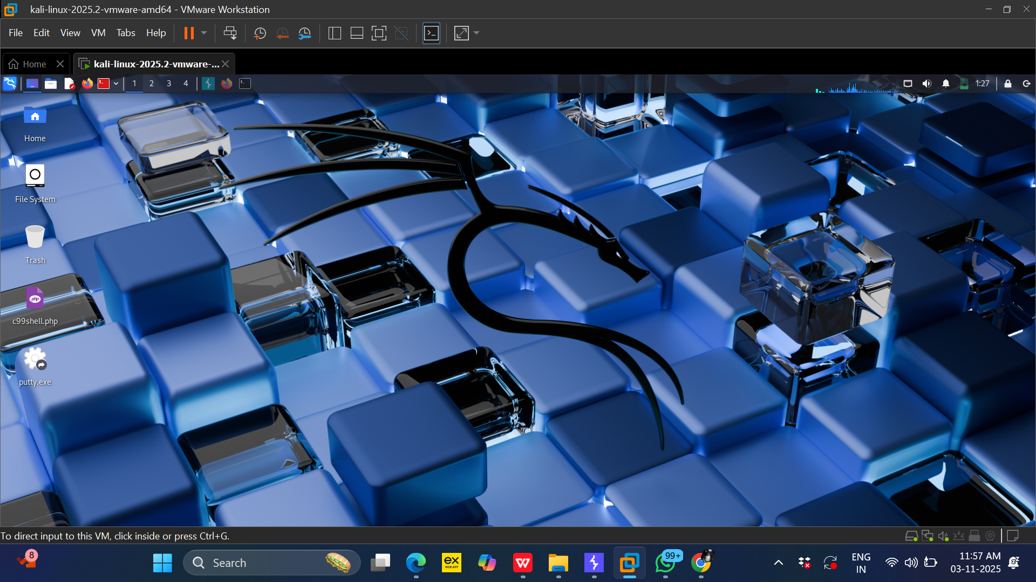
Proof of concept (POC) DVWA
STEP 1 :- Boot up your VM and kali

Slide 16
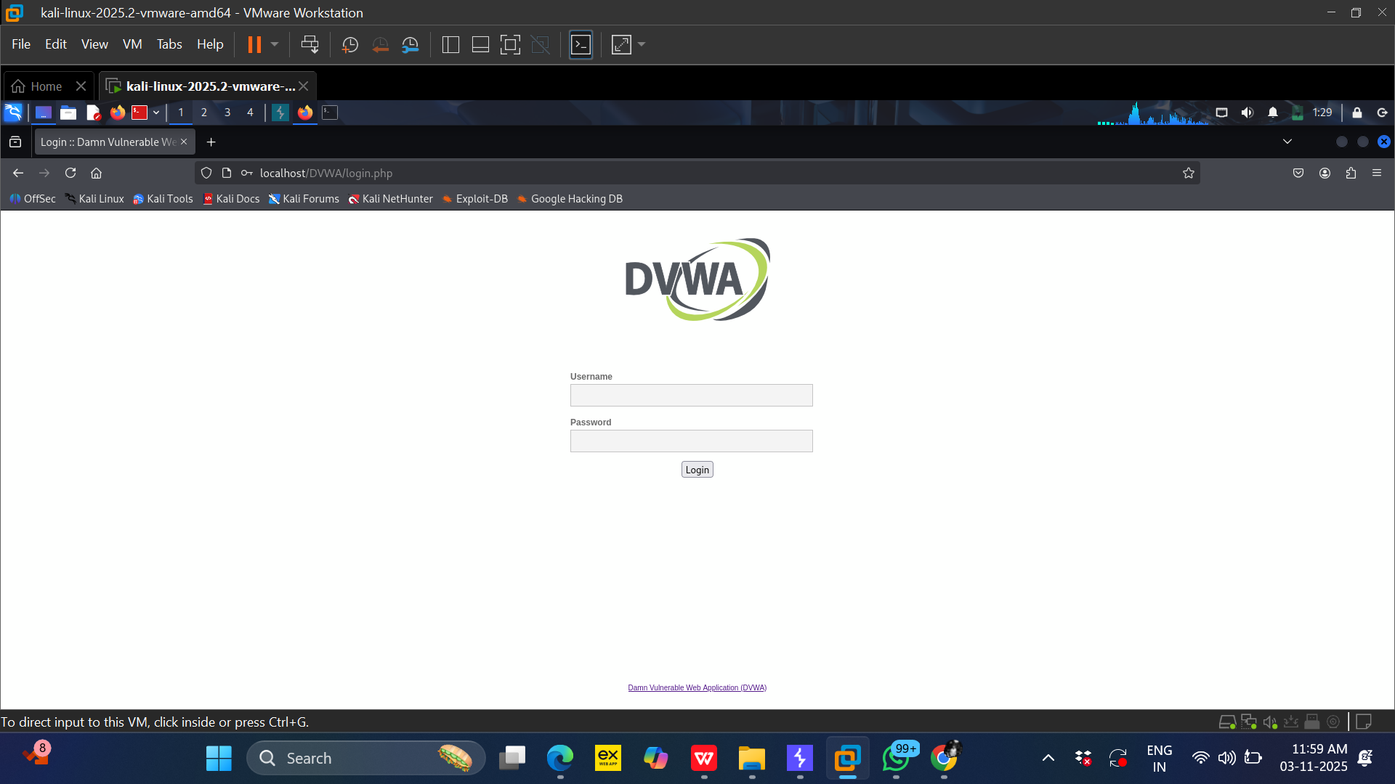
STEP 2 :-Start DVWA website in mozilla browser (victims’s browser).

Slide 17
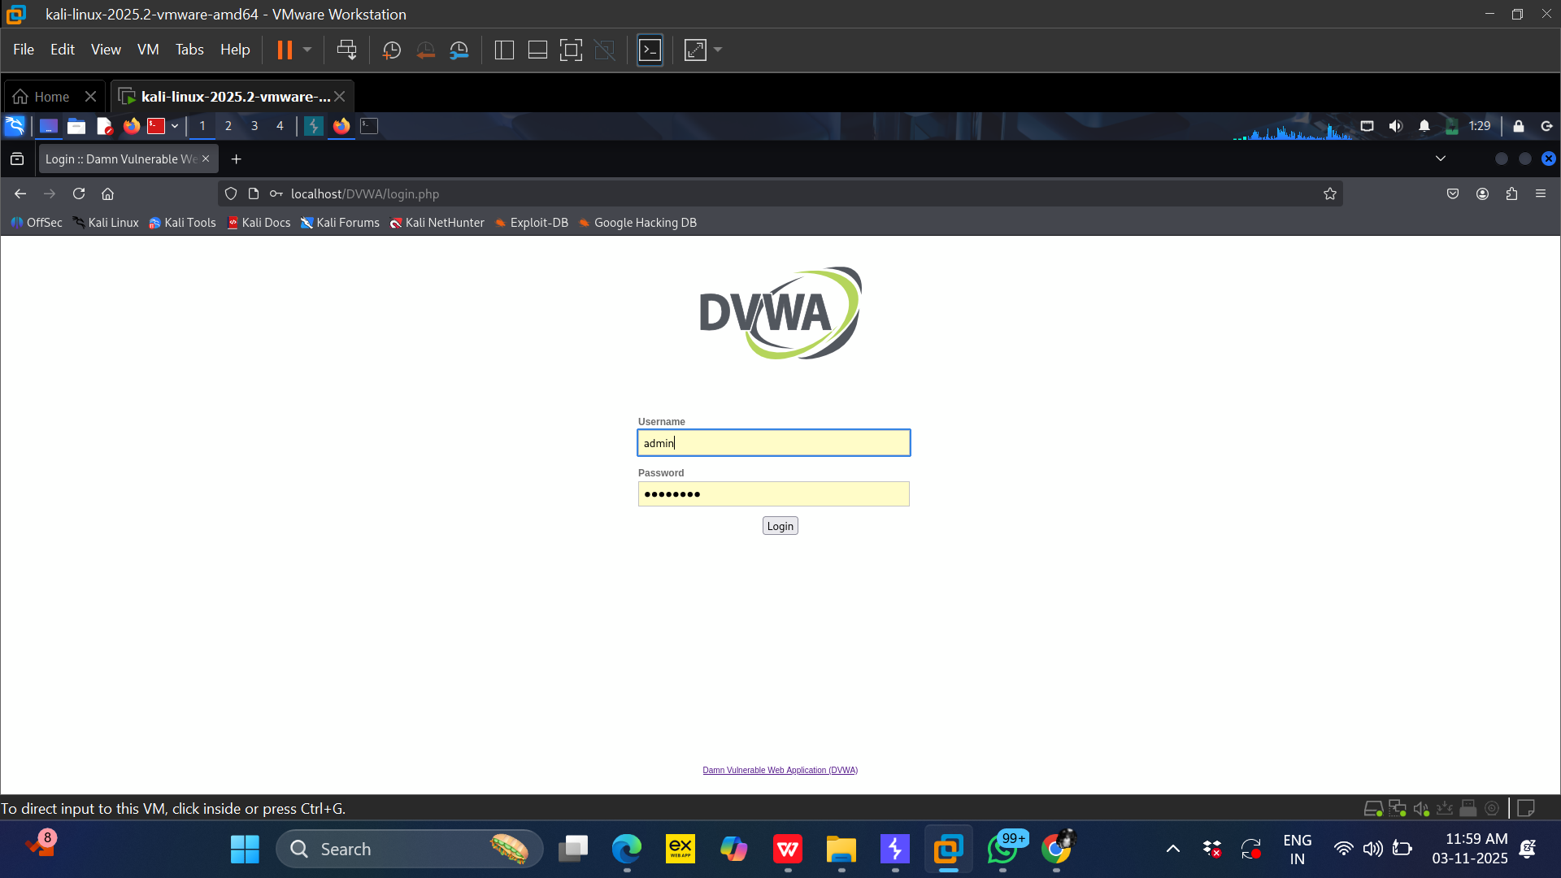
Step 3:- Login to DVWA website using the credentials Username - admin
Password -password

Slide 18
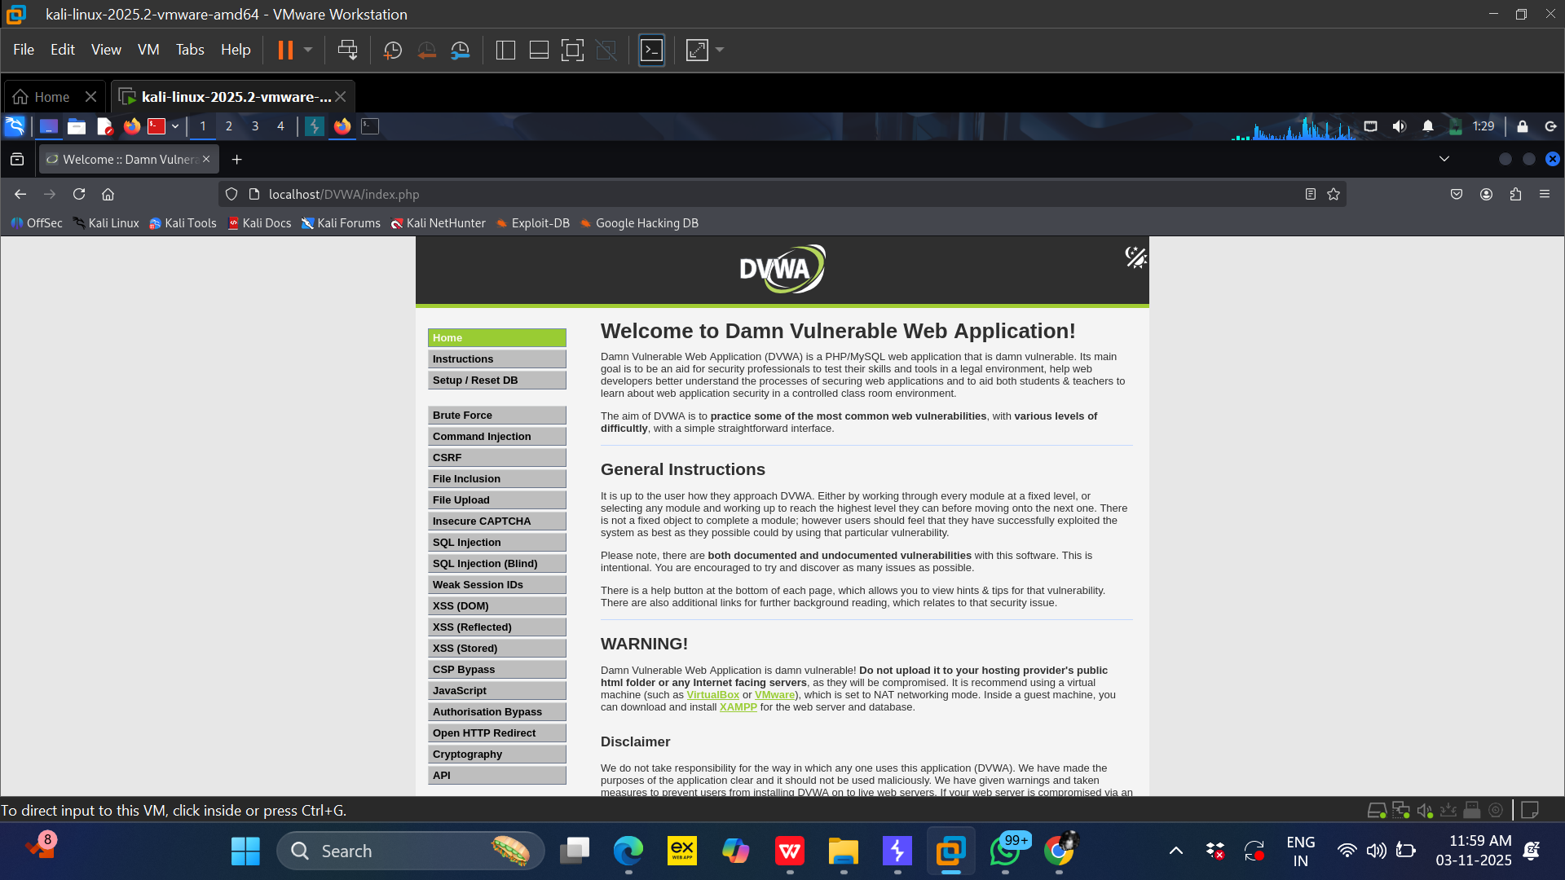
After Login this screen will be available on the browser.

Slide 19
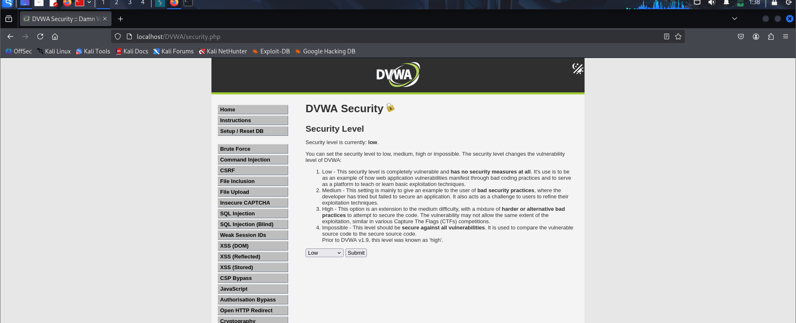
Step 4:- Set the DVWA security level to low.

Slide 20
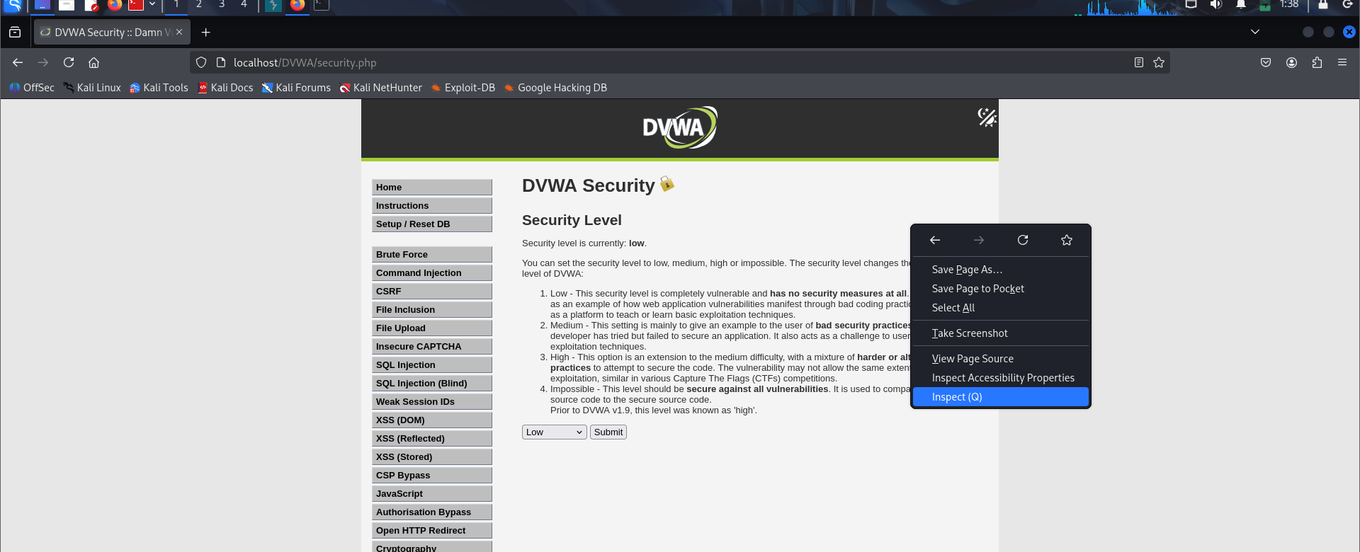
Step 5:- Next right click and select inspect(Q) or press F12.

Slide 21
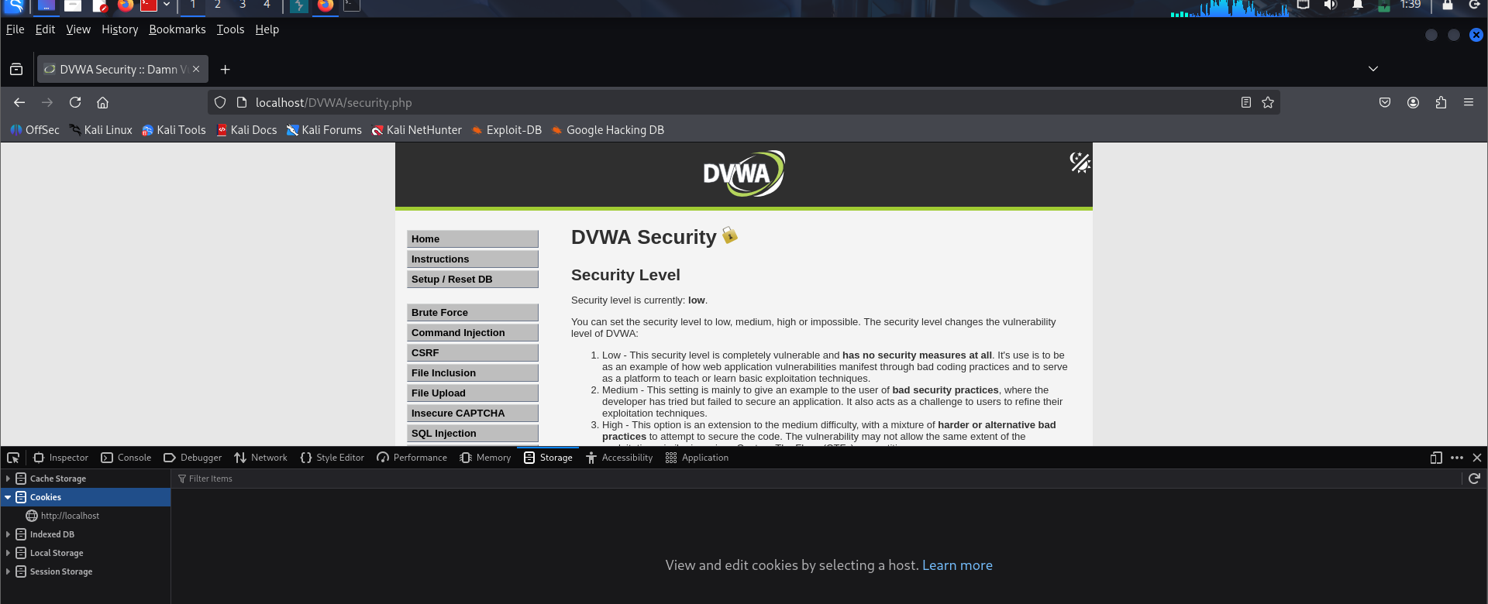
Step 6:- Once the dev mode pops up, click the storage menu to access cookies.

Slide 22
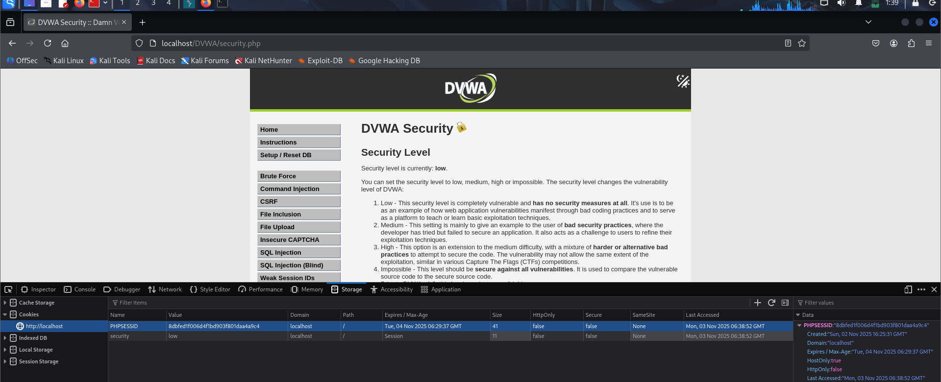
Step 7:- Click on the http://localhost to find your session ID. and copy that value from victims browser.

Slide 23
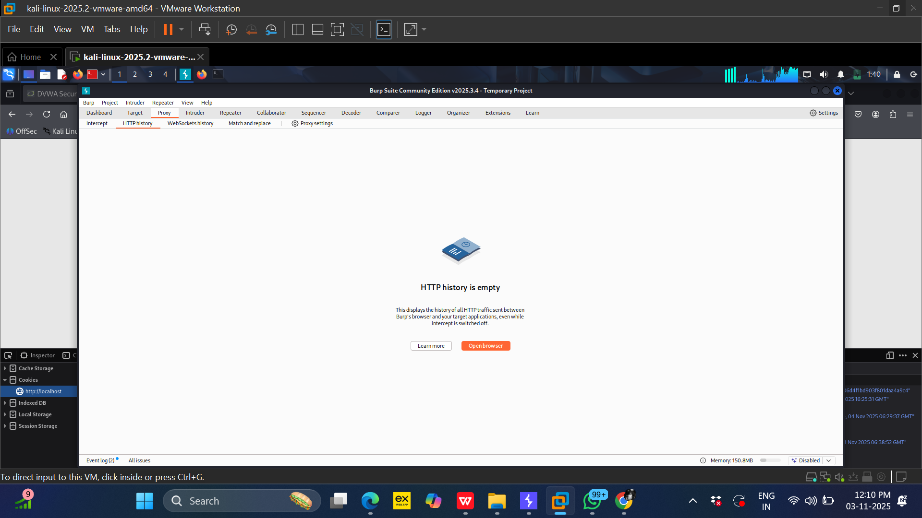
Step 8:- Now open DVWA website on other browser i.e. of (Attackers). Bootup your burp suite and open the burp suite bowser.

Slide 24
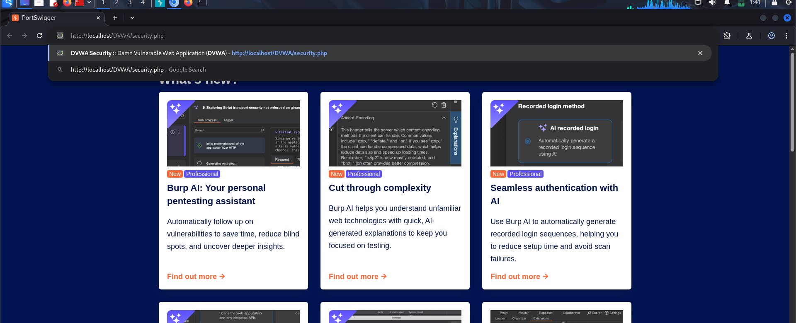
Step 9:- Now open DVWA website on other browser i.e. of (Attackers). Bootup your burp suite and open the burp suite bowser. Now login to DVWA on the burp suite browser.

Slide 25
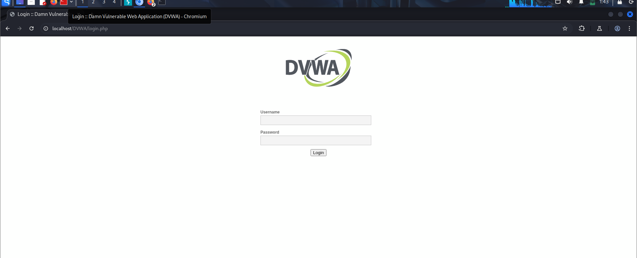
Step 10:- Now you will find the DVWA login page. Before login press Function Key+F12

Slide 26
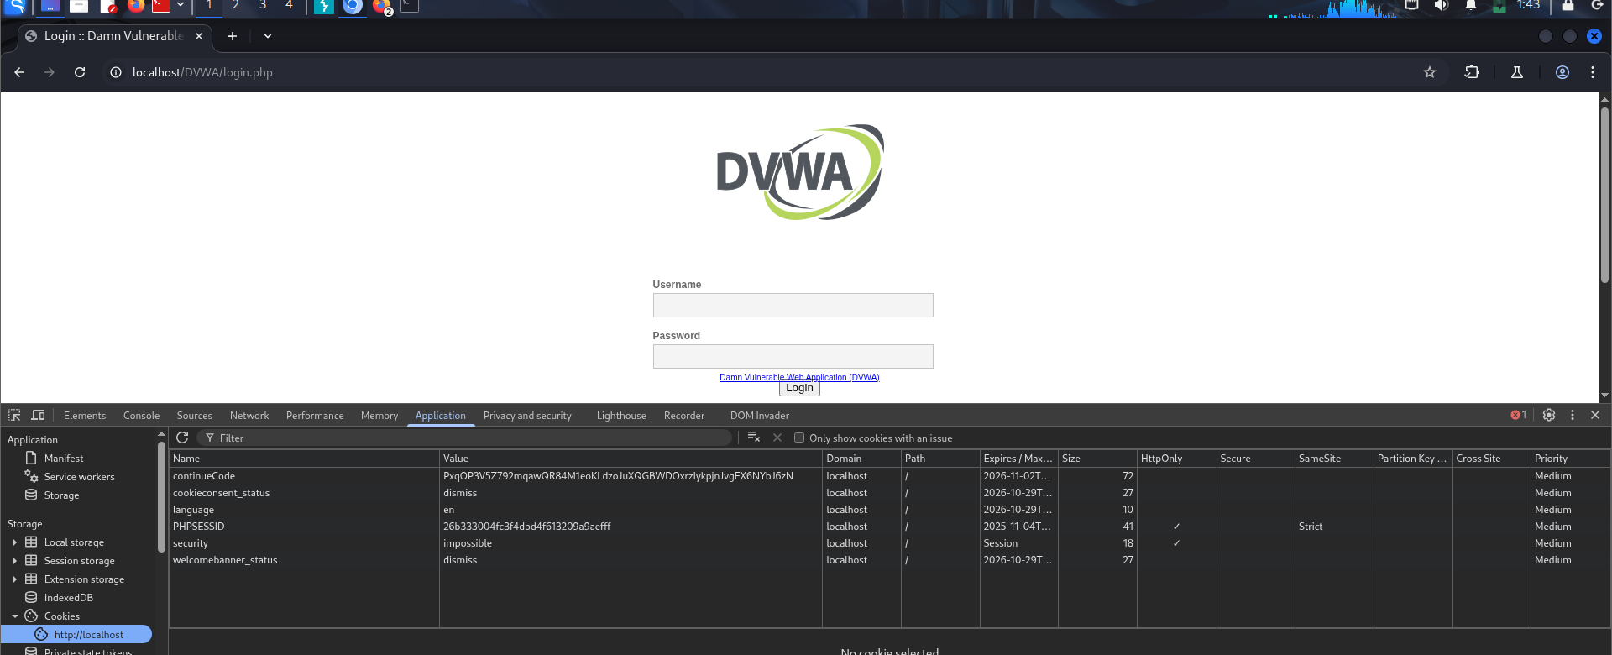
Step 11:- Now acess the dev mode and find the session ID on burp suite browser.

Slide 27
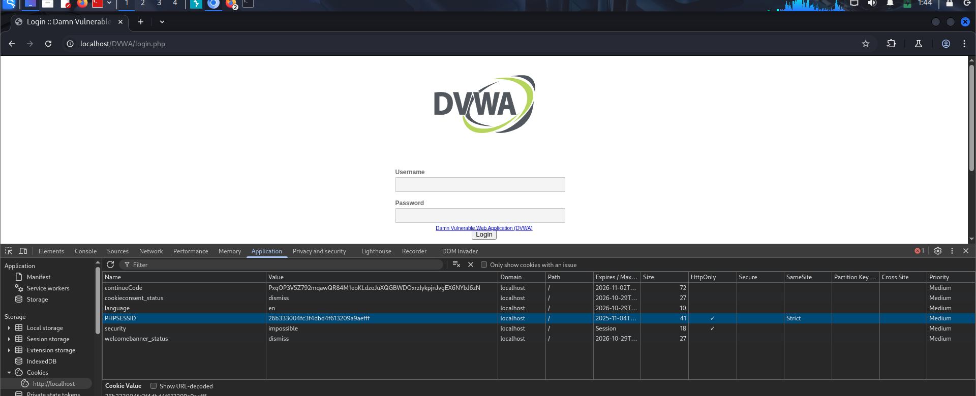
Remove the value given to phpsessid in attackers system.

Slide 28
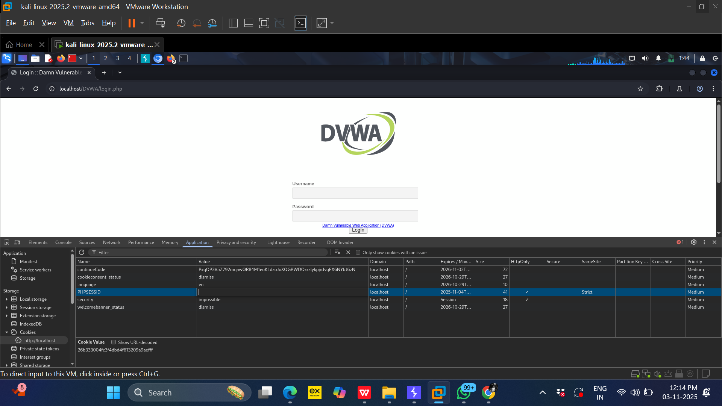

Slide 29
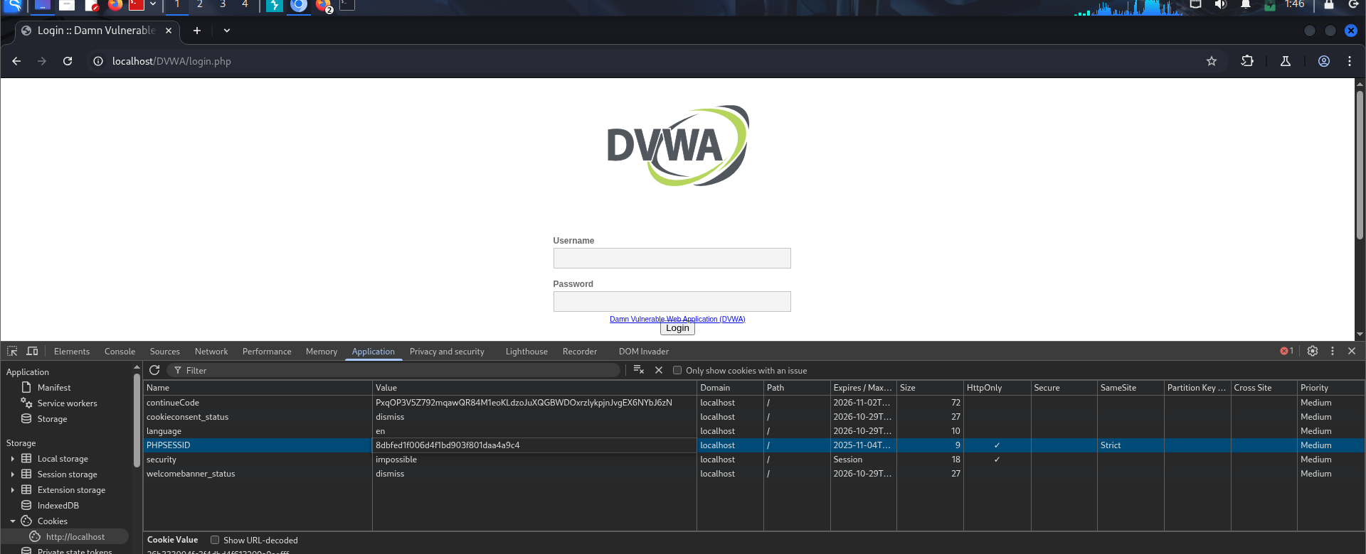
Step 11:- Replace the PHPSESSID or session ID of attackers with victim session ID.

Slide 30
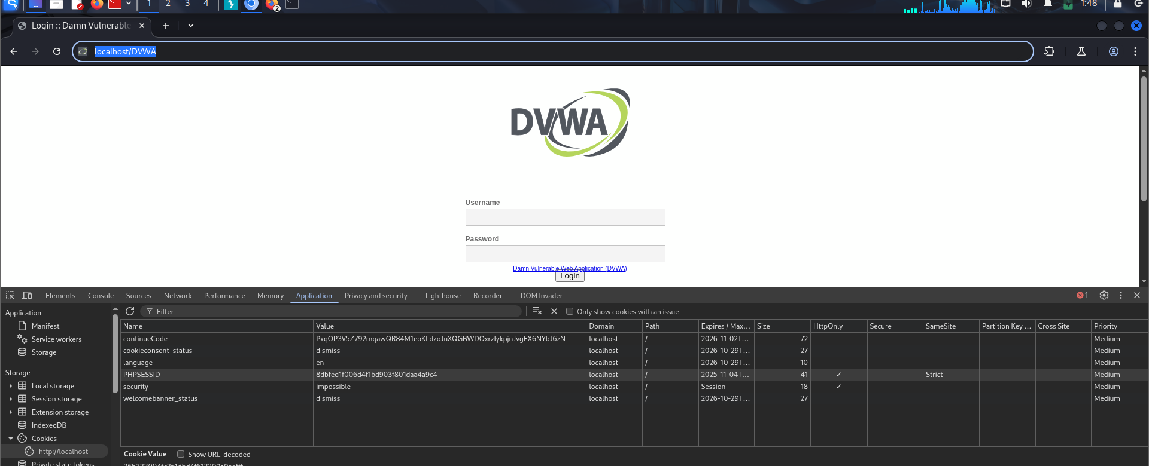
Step 12:- In attackers browser remove the login.php and only use as shown in the browser Refersh the DVWA login page.

Slide 31
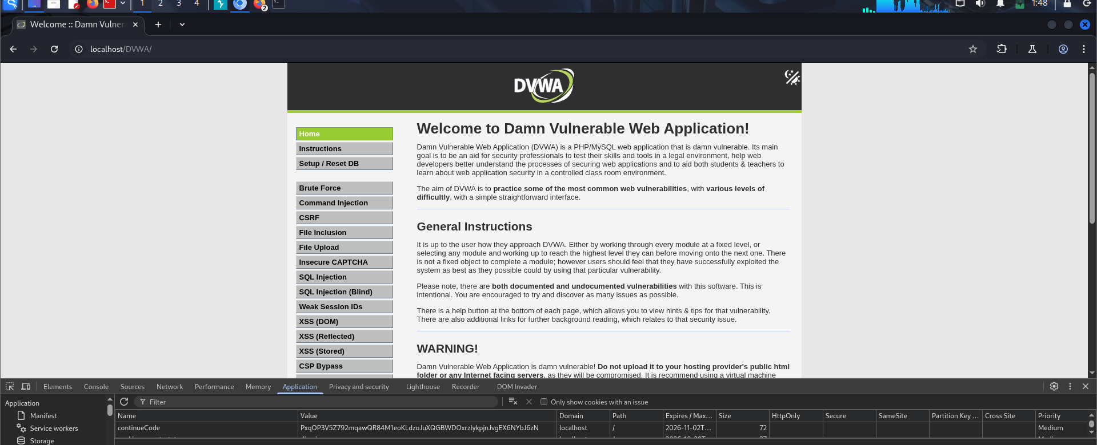
Step 13:- The DVWA sucessfully logged in. In attackers browser we are loggin with victims credentials by replacing the phpsessid value.

Slide 32
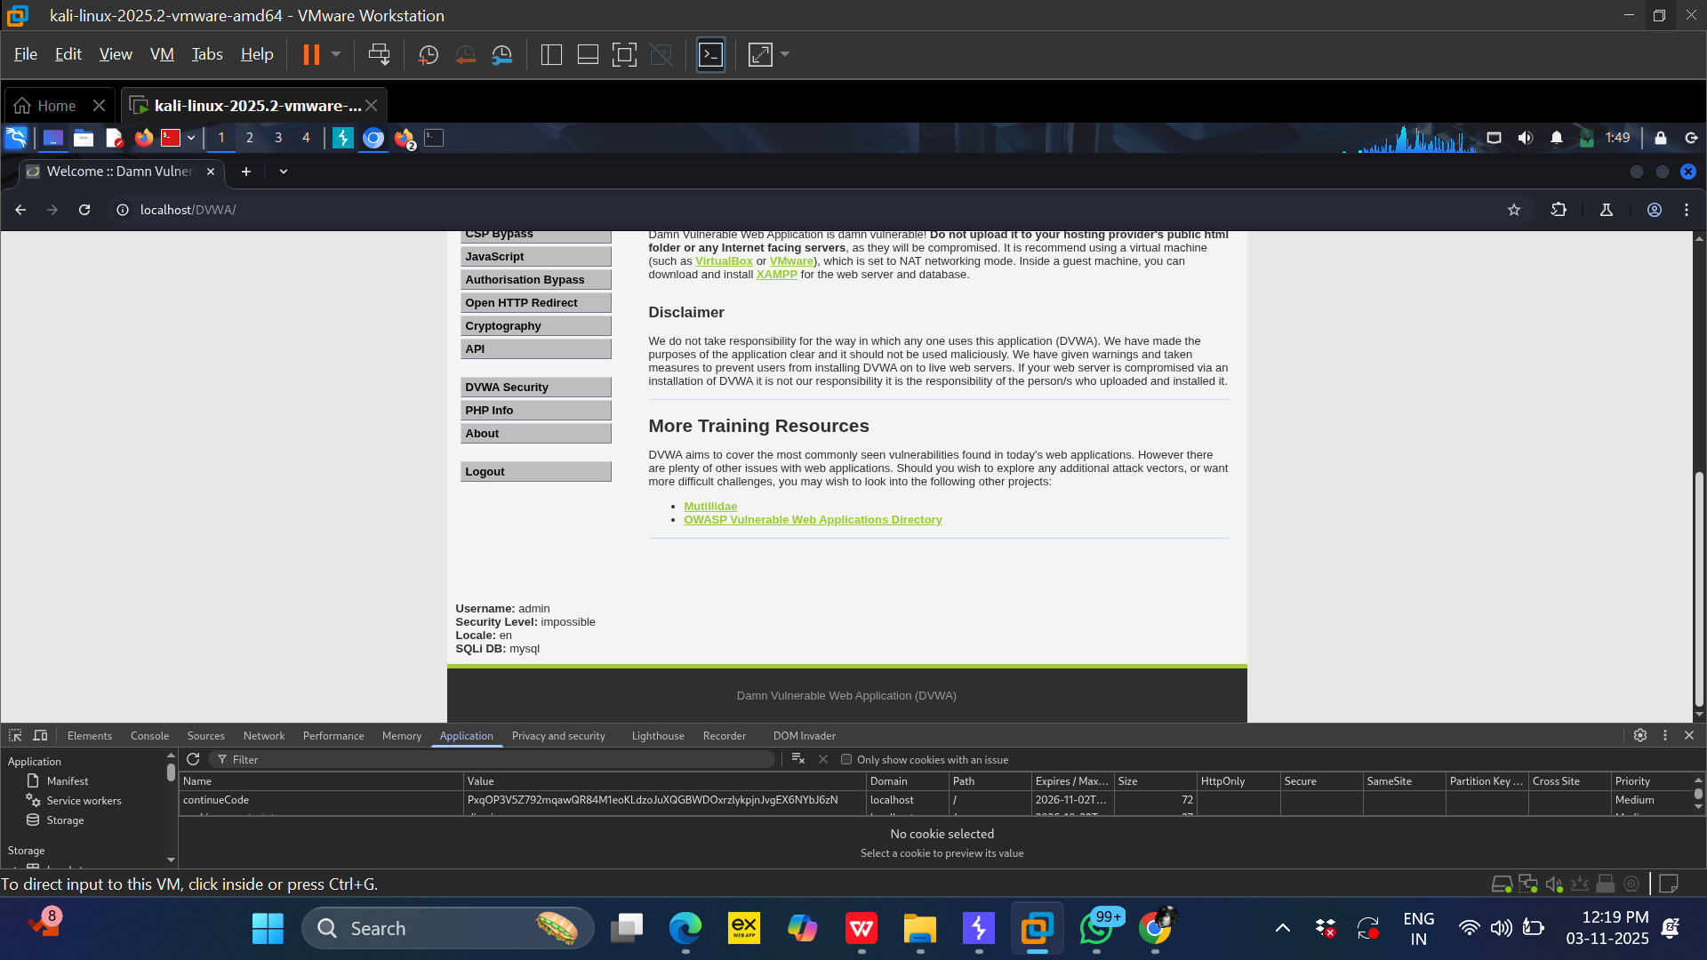

Slide 33
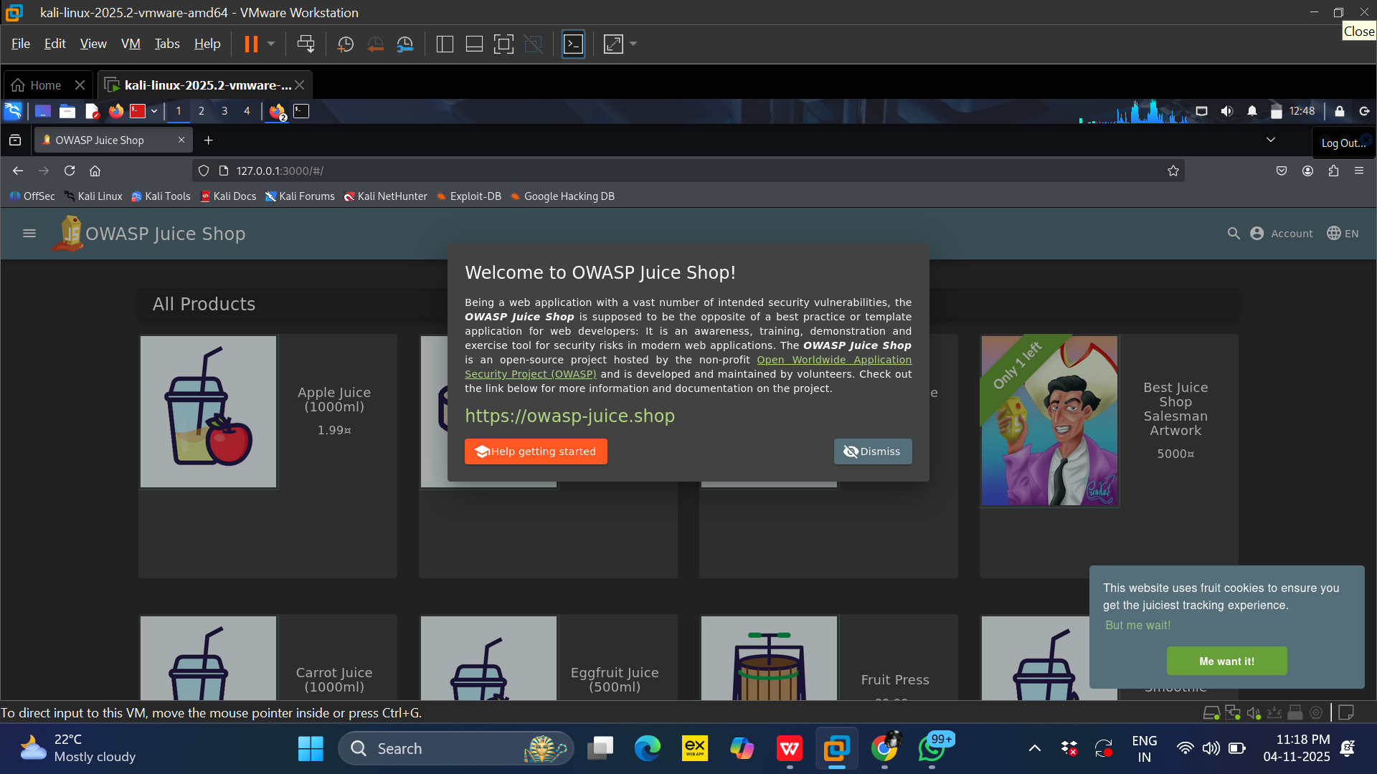
Proof of concept (POC) OWASP JUICE SHOP
STEP 1 :-Start owasp juice shop using DOCKER .After it starts, open the mozilla browser and go to: http://127.0.0.1:3000. (victims’s browser)

Slide 34
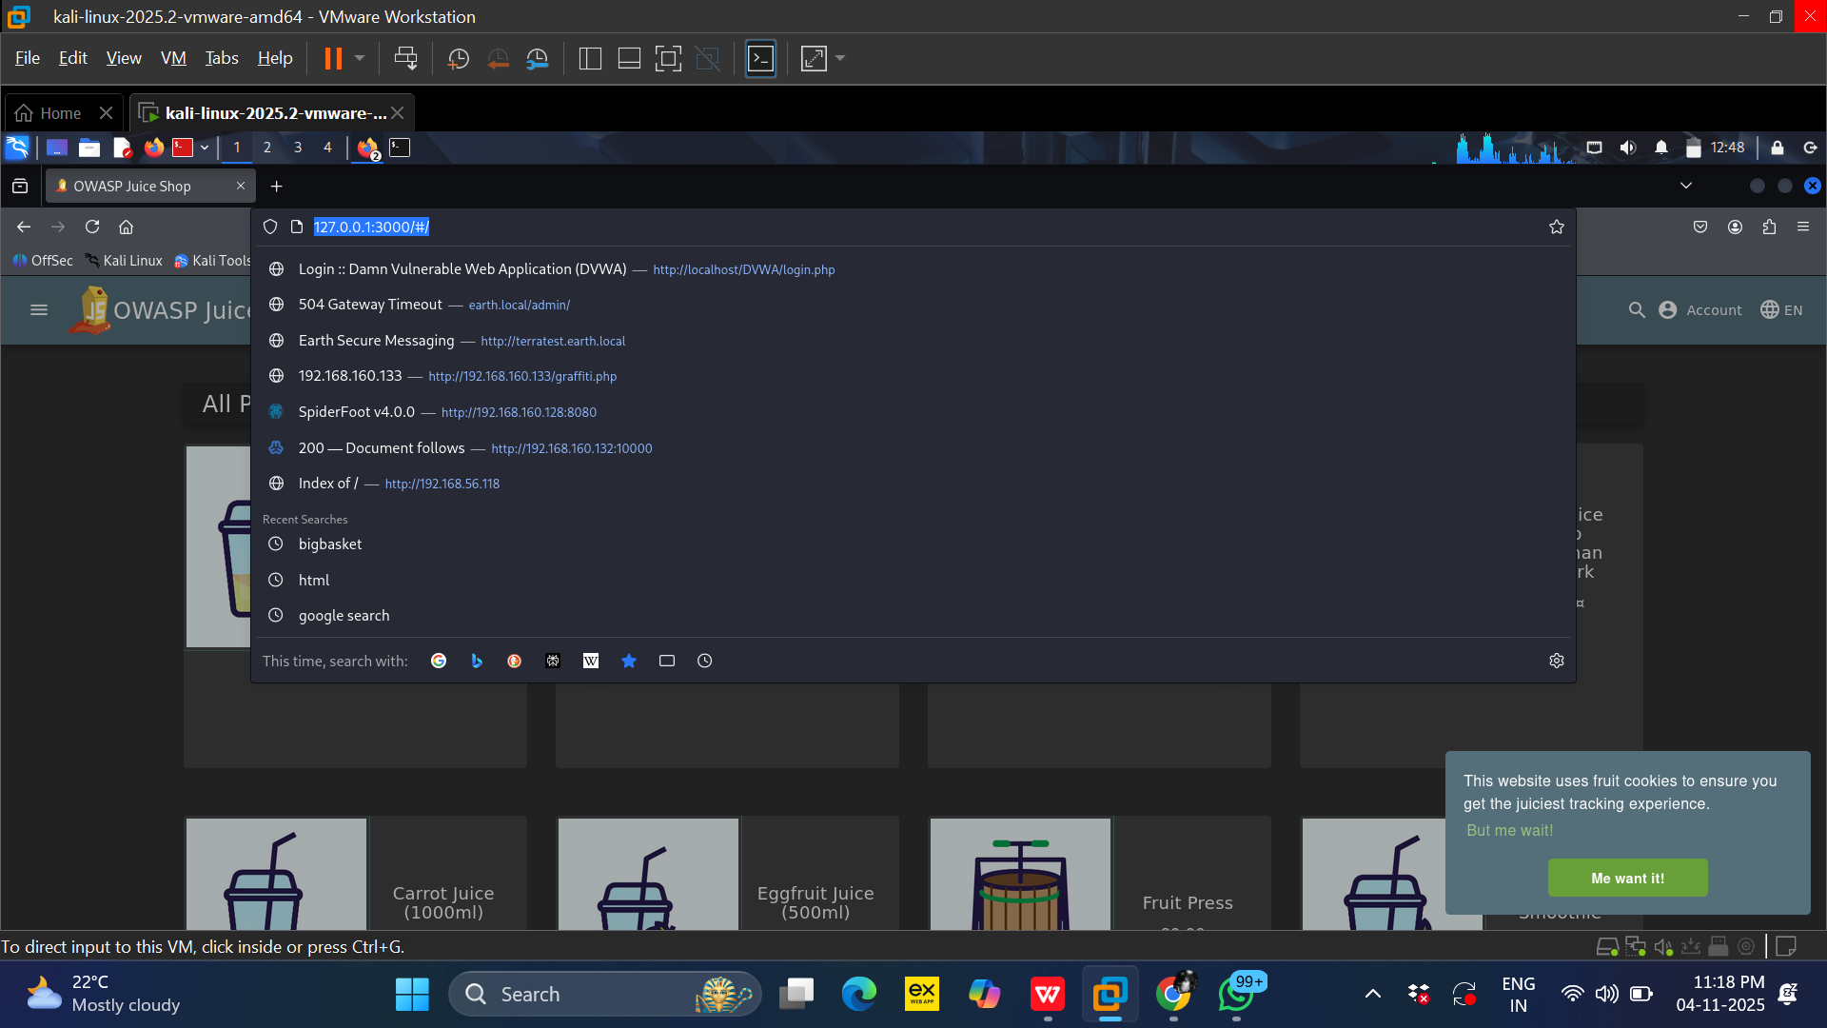
After acessing the link shown . This screen will be available on the browser.

Slide 35
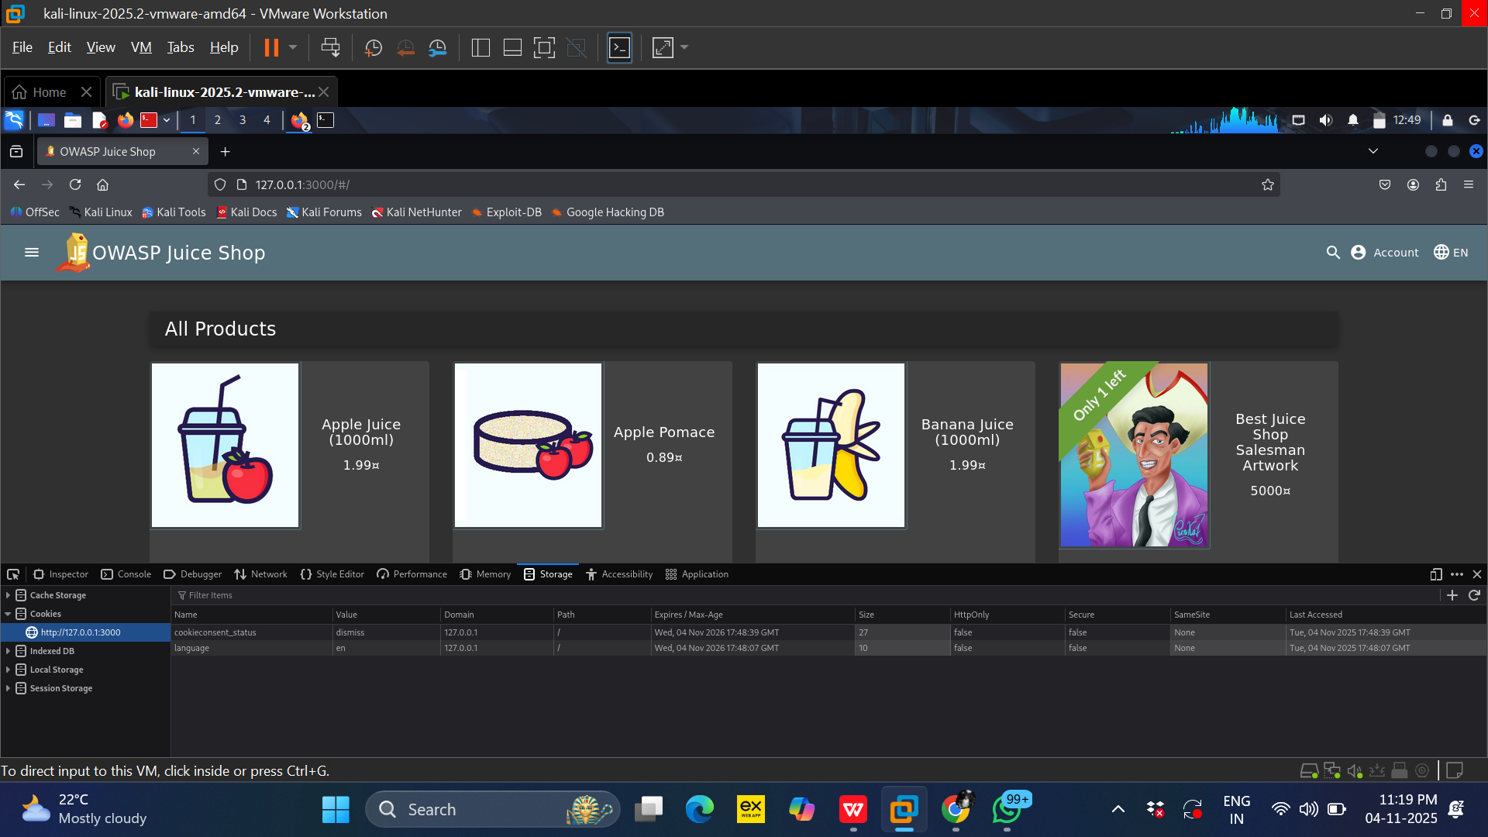
Step 2:- Next right click and select inspect(Q) or press F12. Then Once the dev mode pops up, click the storage menu to access cookies.

Slide 36
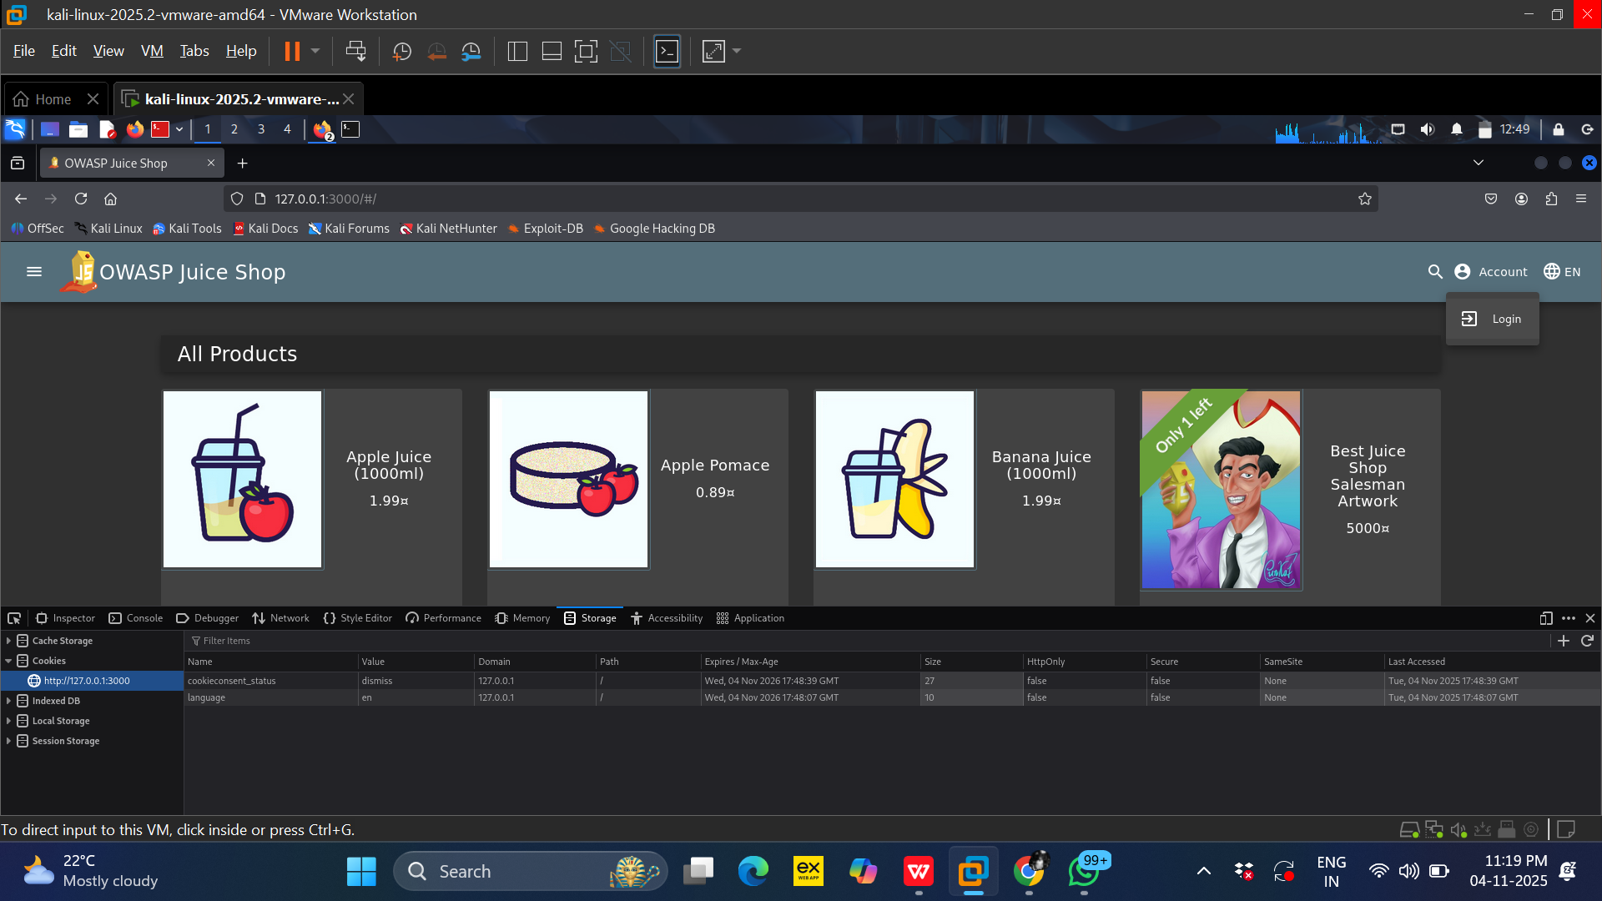
Step3-: Since the session ID is not visible on that page, we must log in to access it. Look for the login option at the top right of the screen.

Slide 37
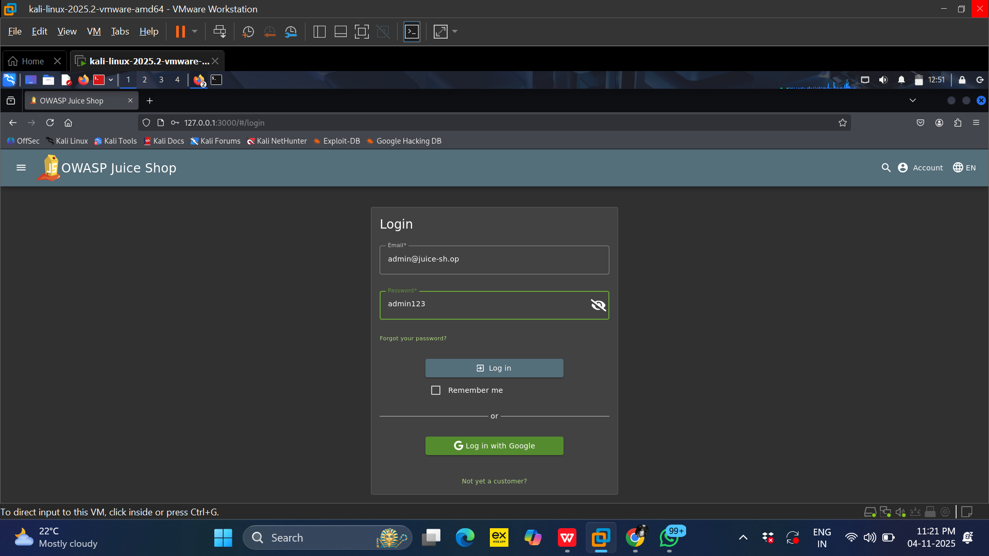
Step4:- Log in to the OWASP Juice Shop using the following credentials:
Username: admin@juice-sh.op Password: admin123

Slide 38
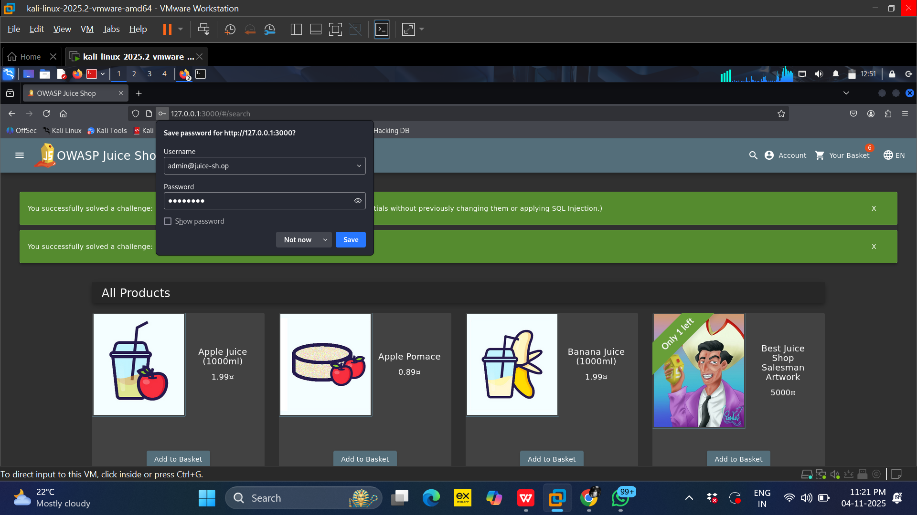
Step5:- Once you log in, you will be presented with a page similar to the one displayed above.

Slide 39
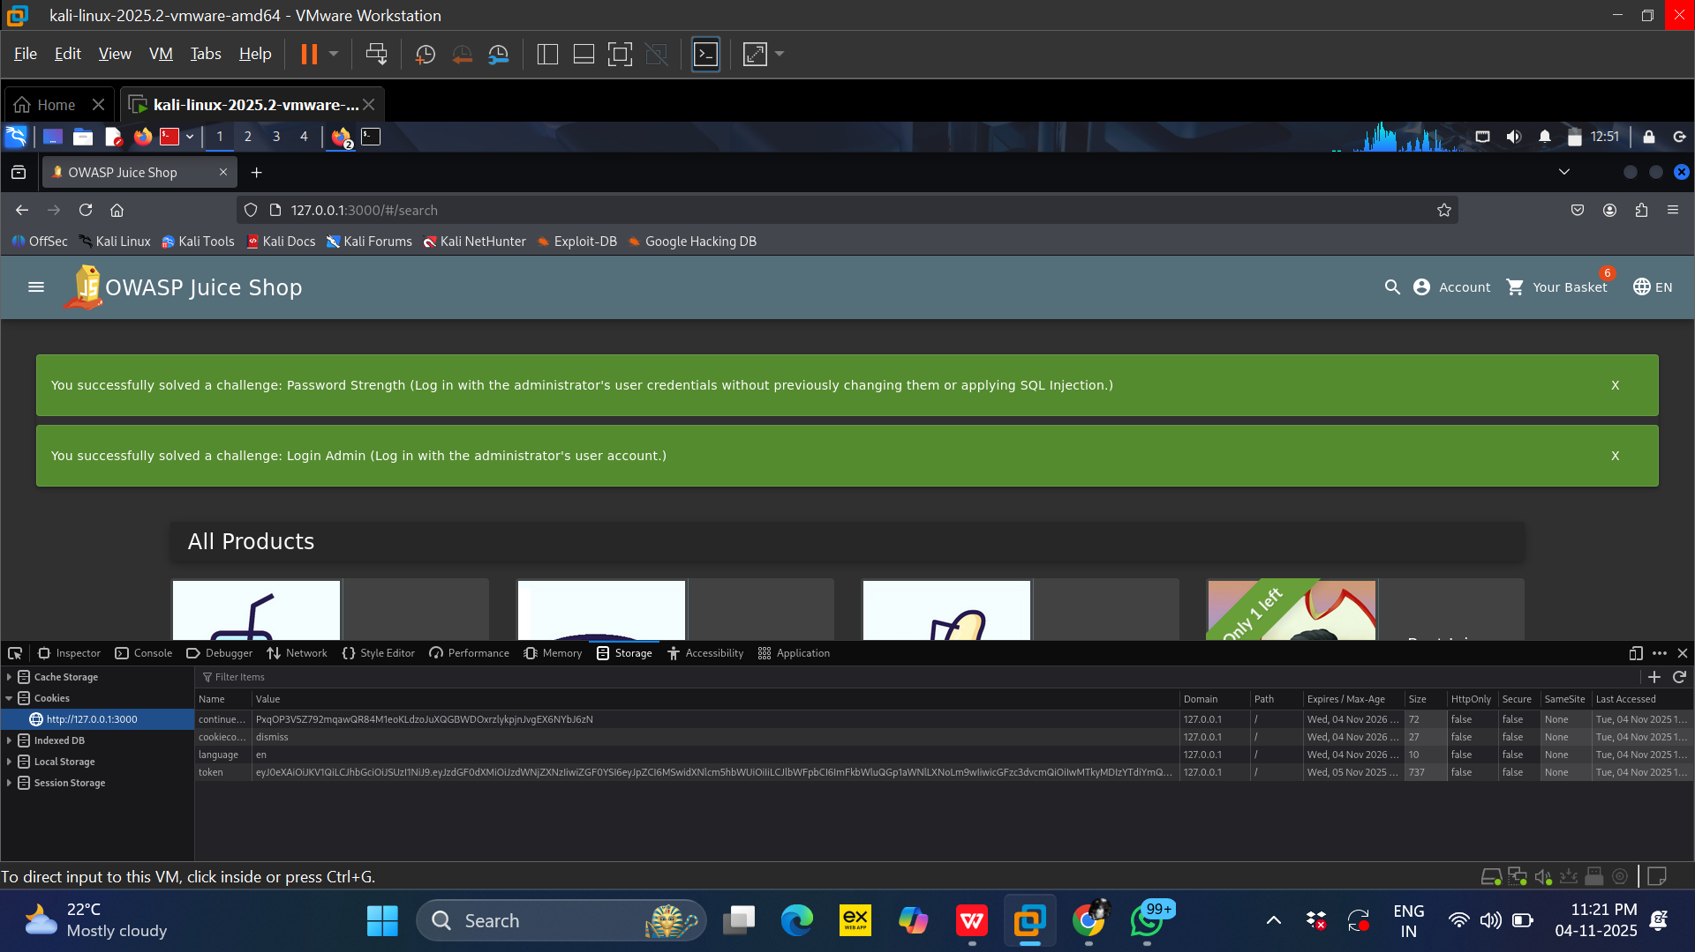
Step6:- Open the Developer Tools again, and you will now find a cookie that contains the Session ID (or PHPSESSID) as the token.

Slide 40
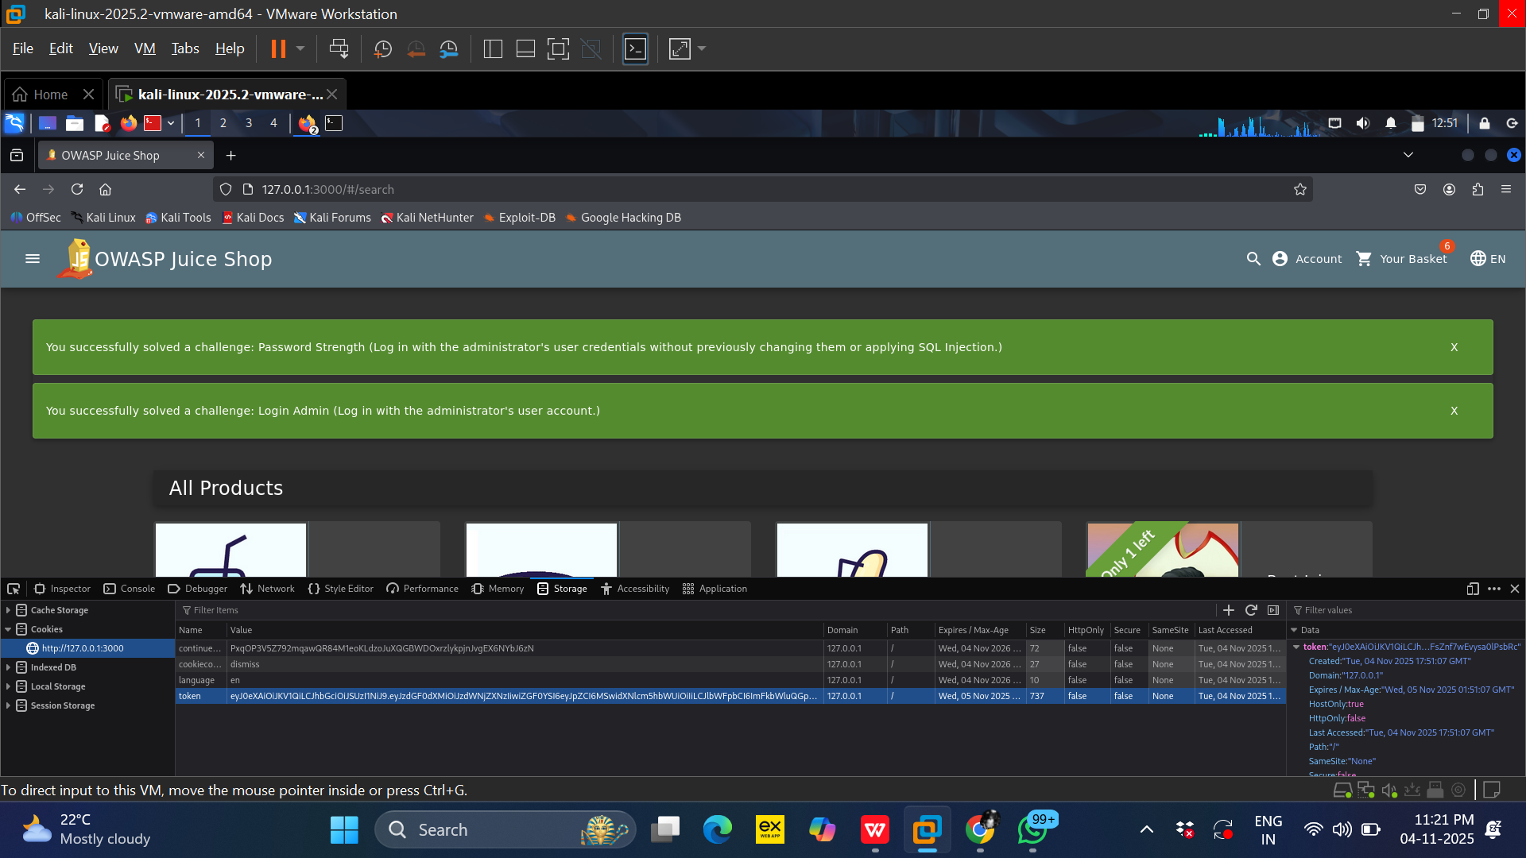
Step7:-For better clarity, the Session ID has been highlighted.

Slide 41
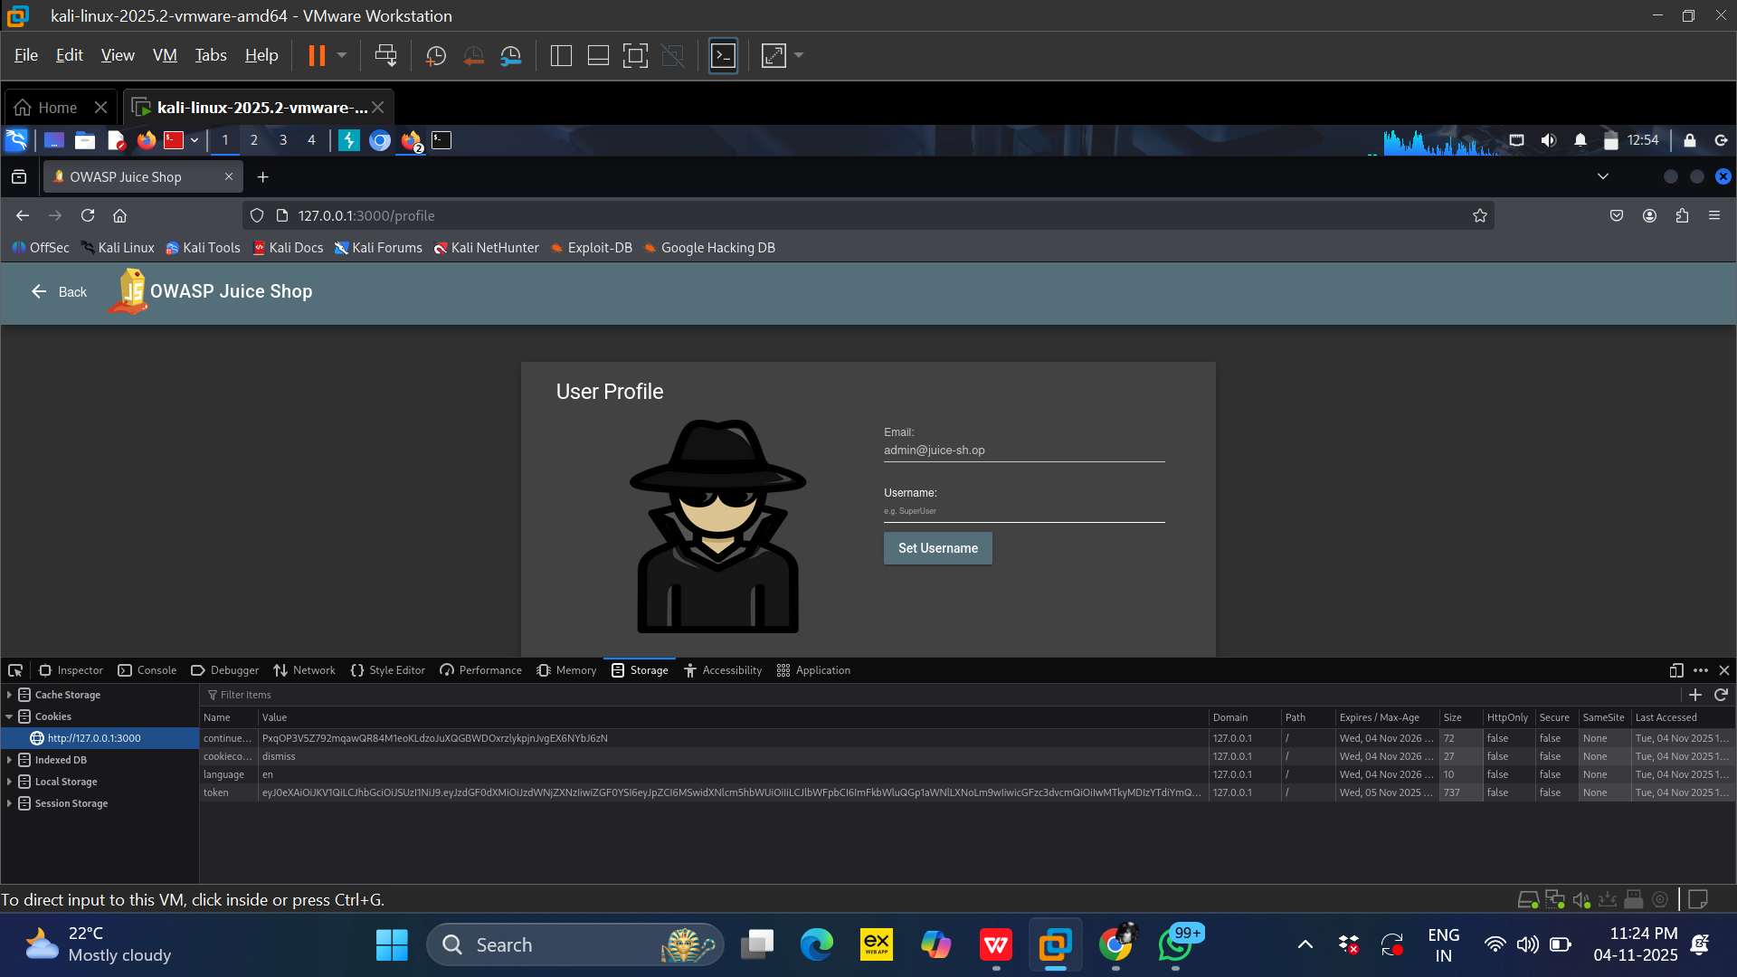
Step8:-You should now see the victim’s account. For better understanding, note that the username displayed is admin@juice-sh.op (sometimes shown as superuser).

Slide 42
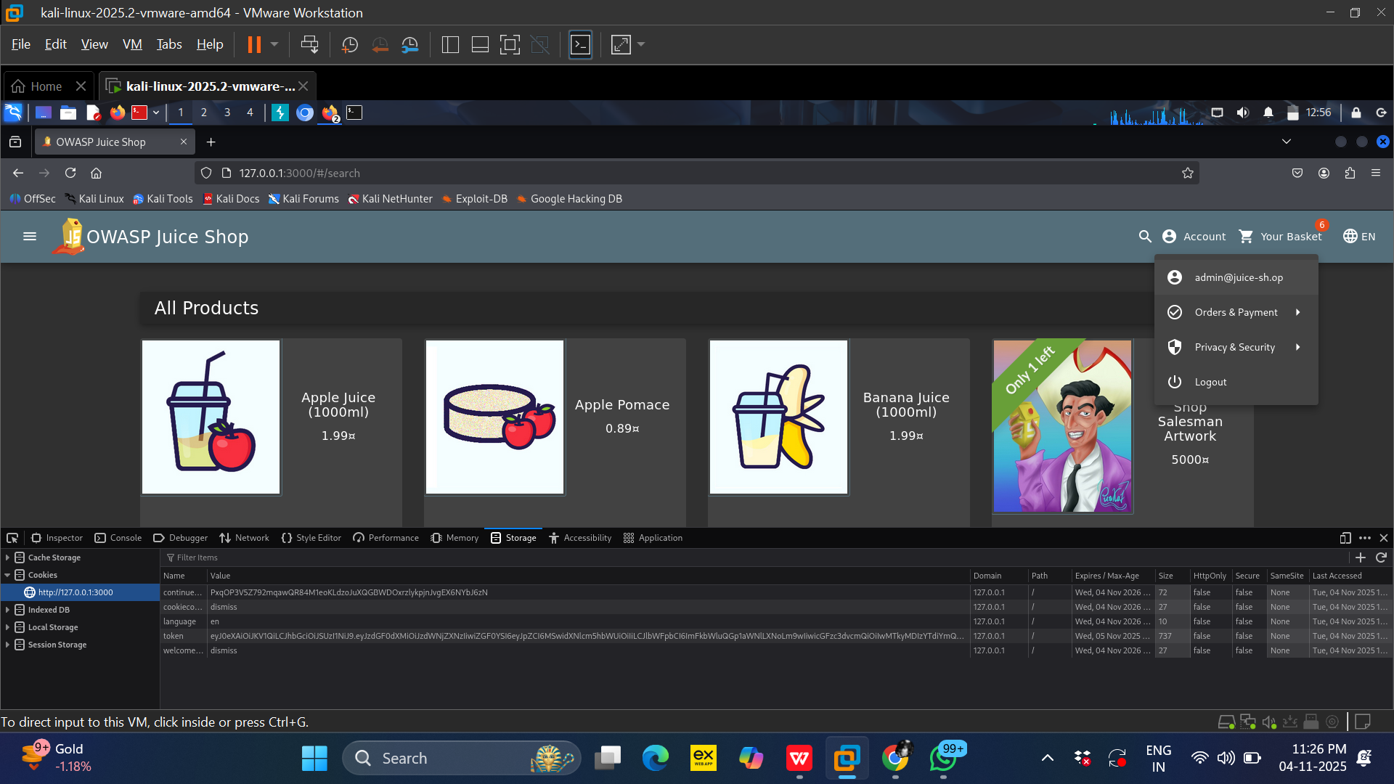
Step9:-Copy the Session ID (token) from the cookie.

Slide 43
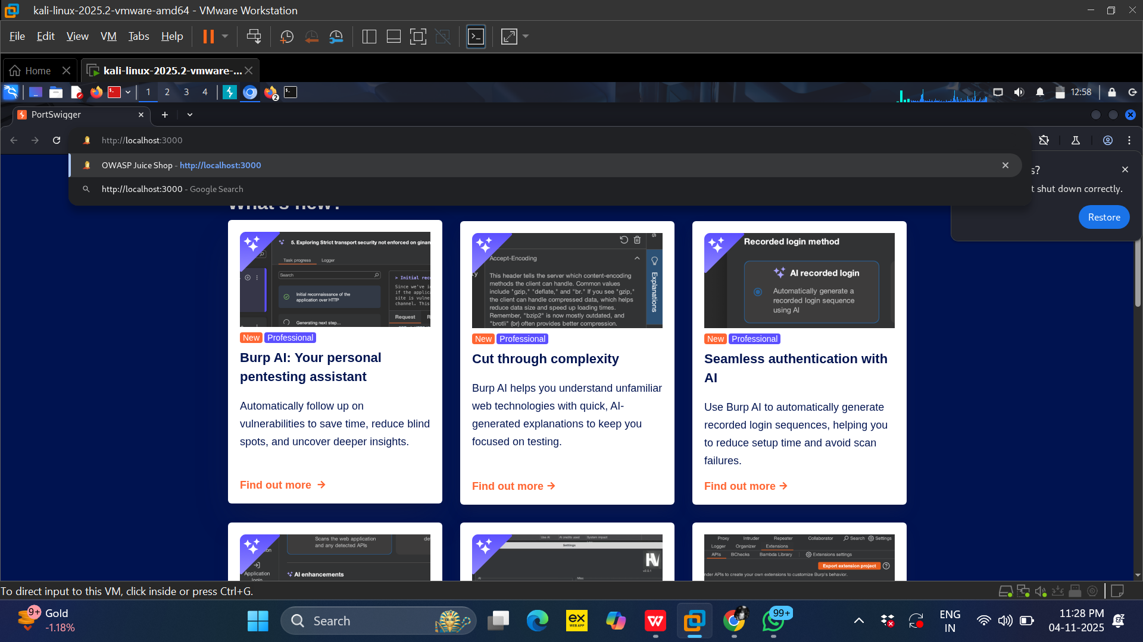
Step10:- Open the OWASP Juice Shop in a different browser representing the attacker. In this demonstration, the attacker’s browser is Burp Suite’s browser.

Slide 44
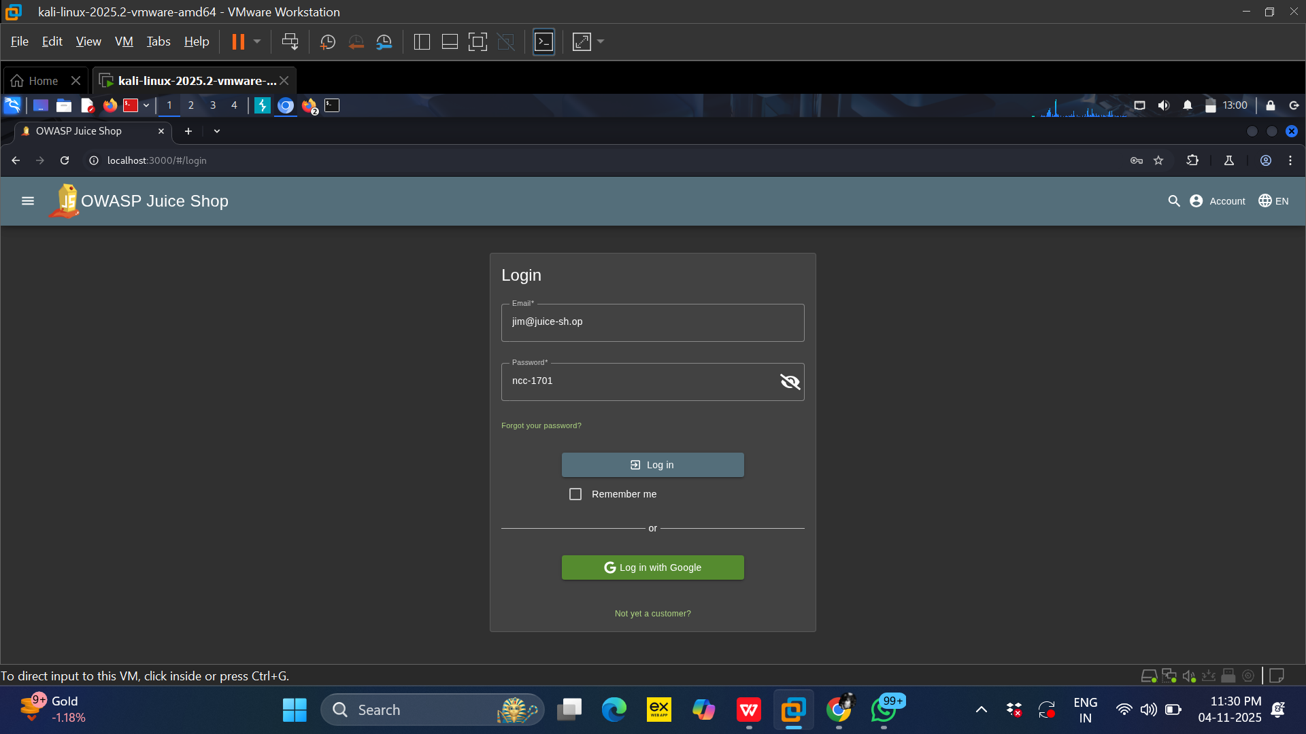
Step11 :-The attacker then authenticates to the OWASP Juice Shop using the following credentials: Username jim@juice-sh.op, Password ncc-17701.

Slide 45
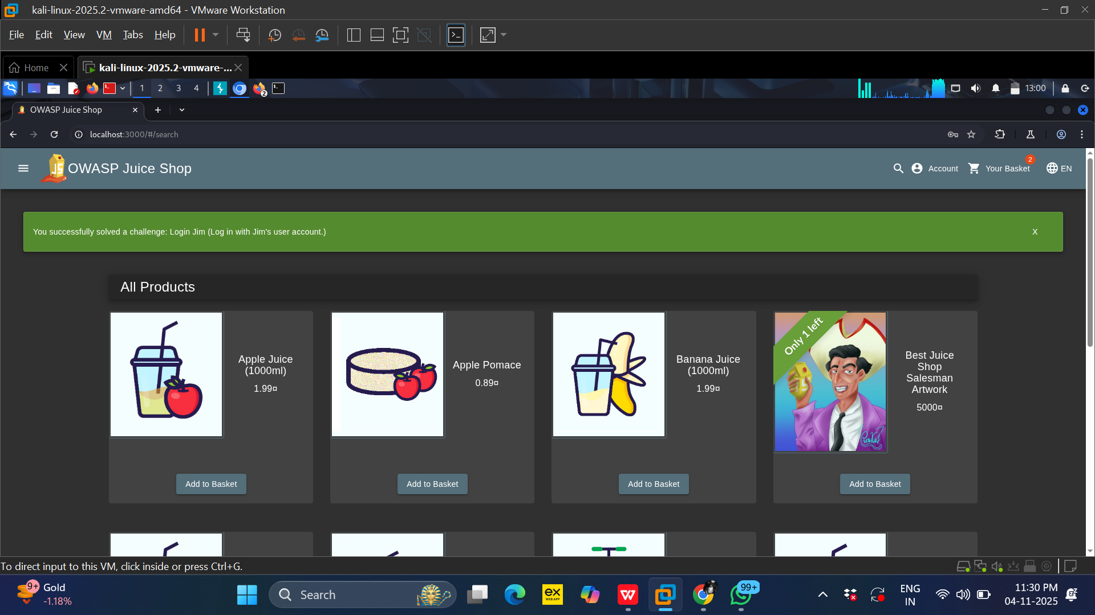
Step12:-The attacker is now logged in; the active user account is Jim.

Slide 46
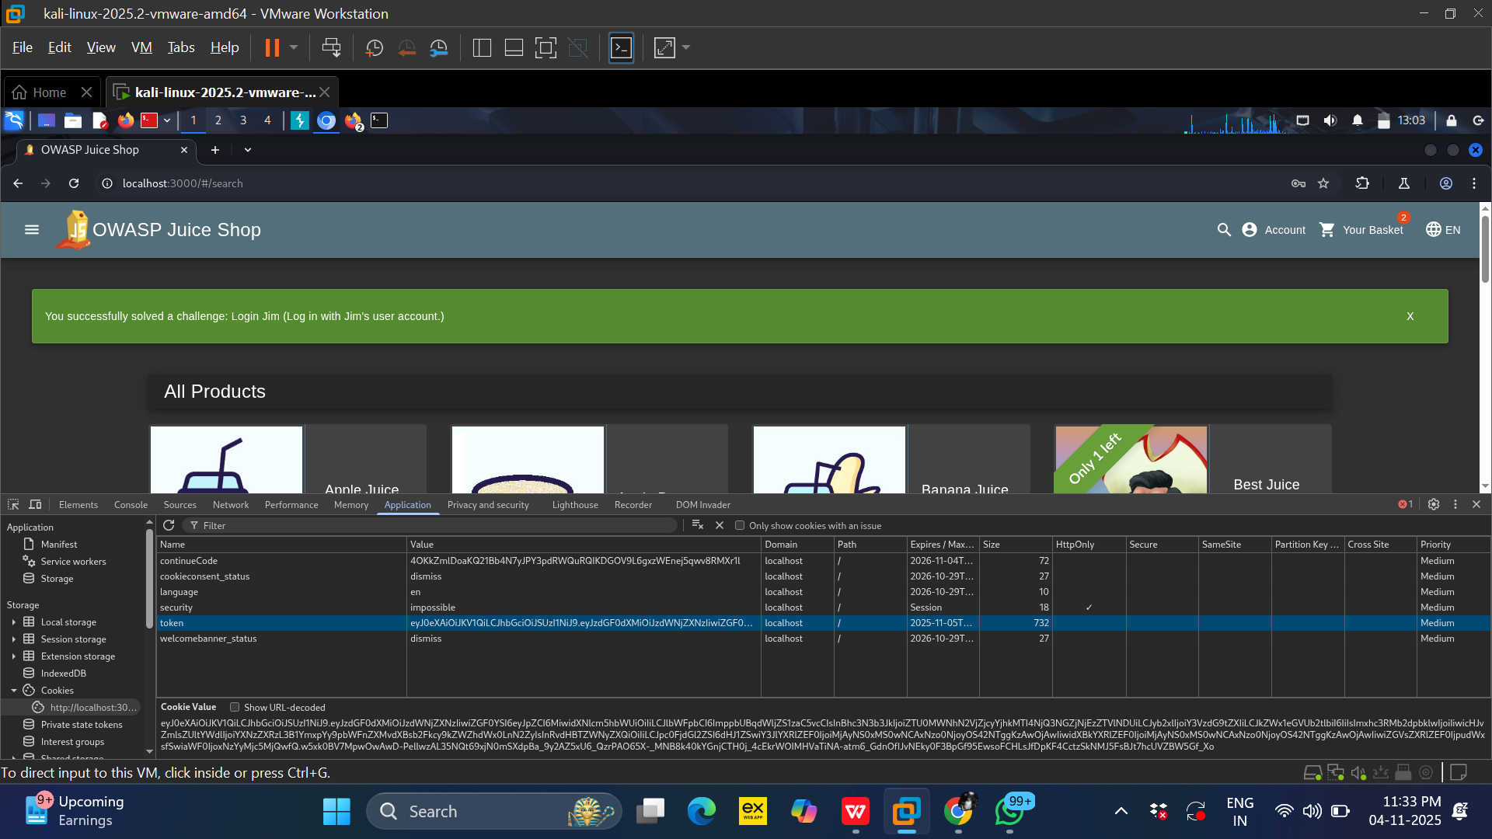
Step13:-As highlighted in the image above, this is the Session ID belonging to the attacker (Jim).

Slide 47
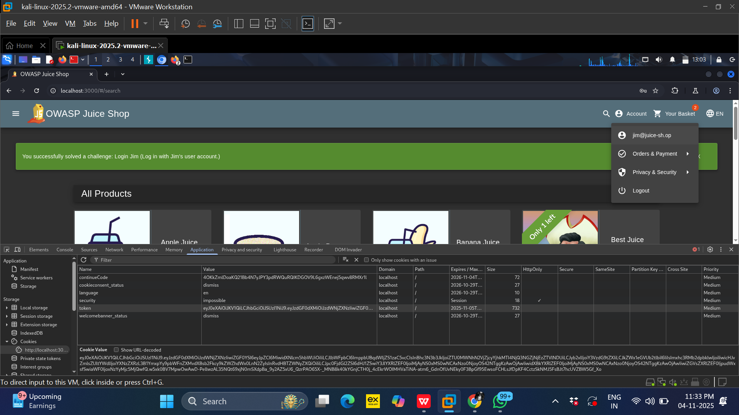
Step14:-For clarity and confirmation, the account name is shown in the upper-right corner of the screen.

Slide 48
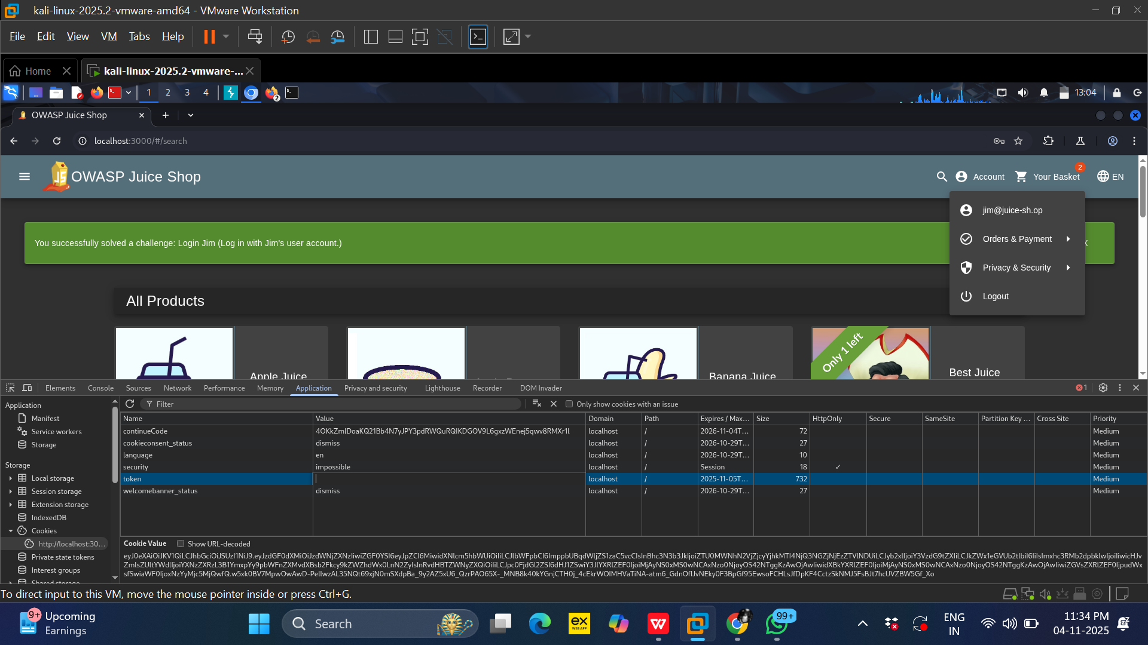
Step15:- Now the attacker removes their session ID.

Slide 49
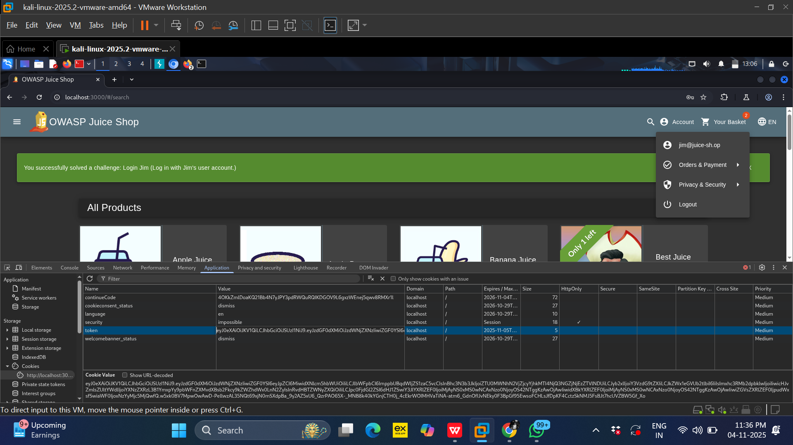
Step16:- The attacker then replaces the victim’s Session ID (copied earlier) in the attacker’s browser to hijack the victim’s session.

Slide 50
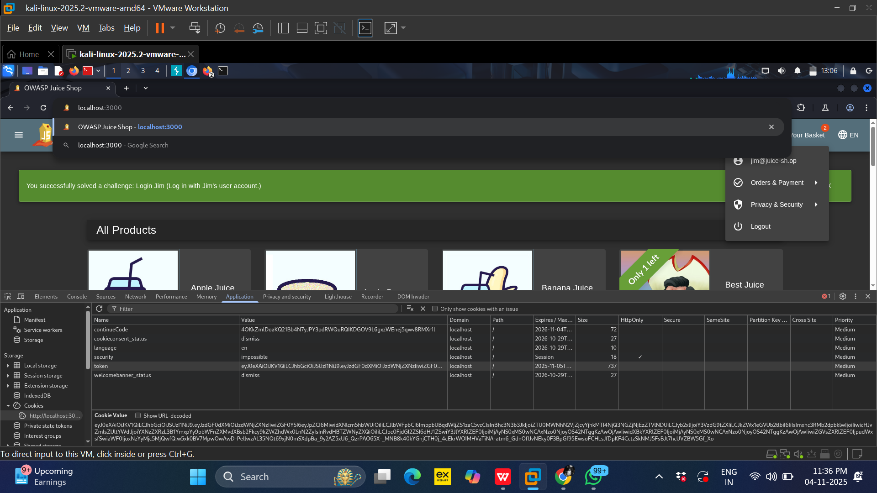
Step17:-Clear few text in the search bar and refresh the page, as demonstrated in the figure above.

Slide 51
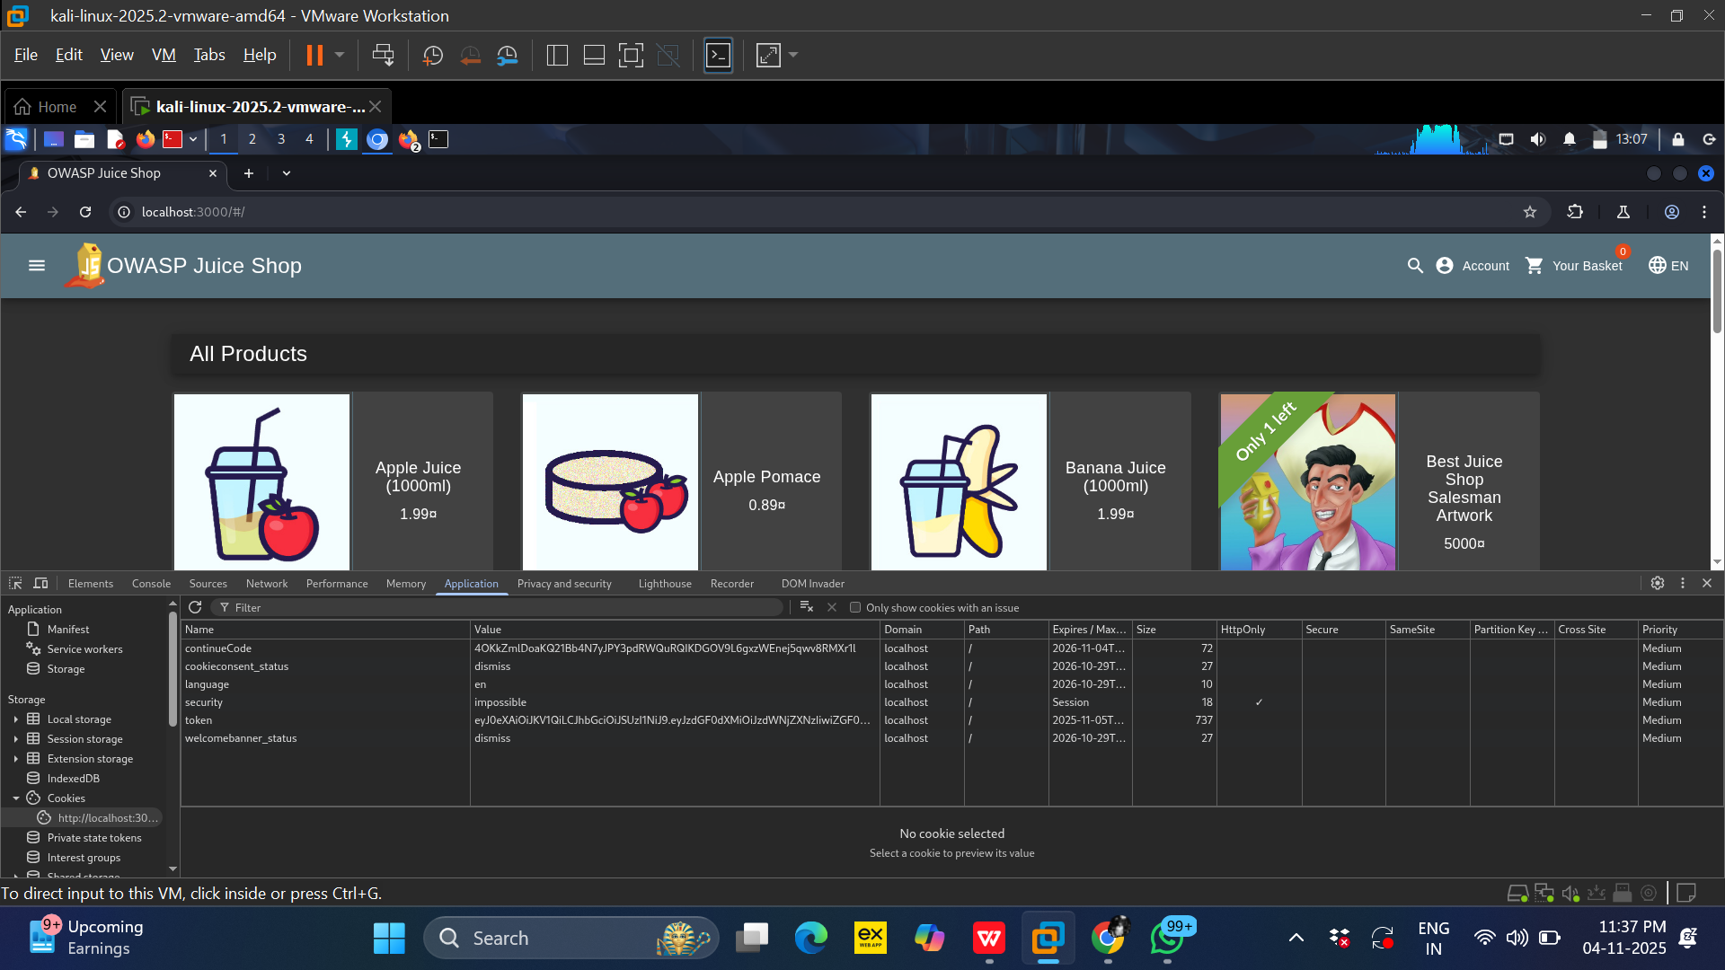
Step18:- After refreshing the page, the attacker is logged into the victim’s account without needing the victim’s login credentials

Slide 52
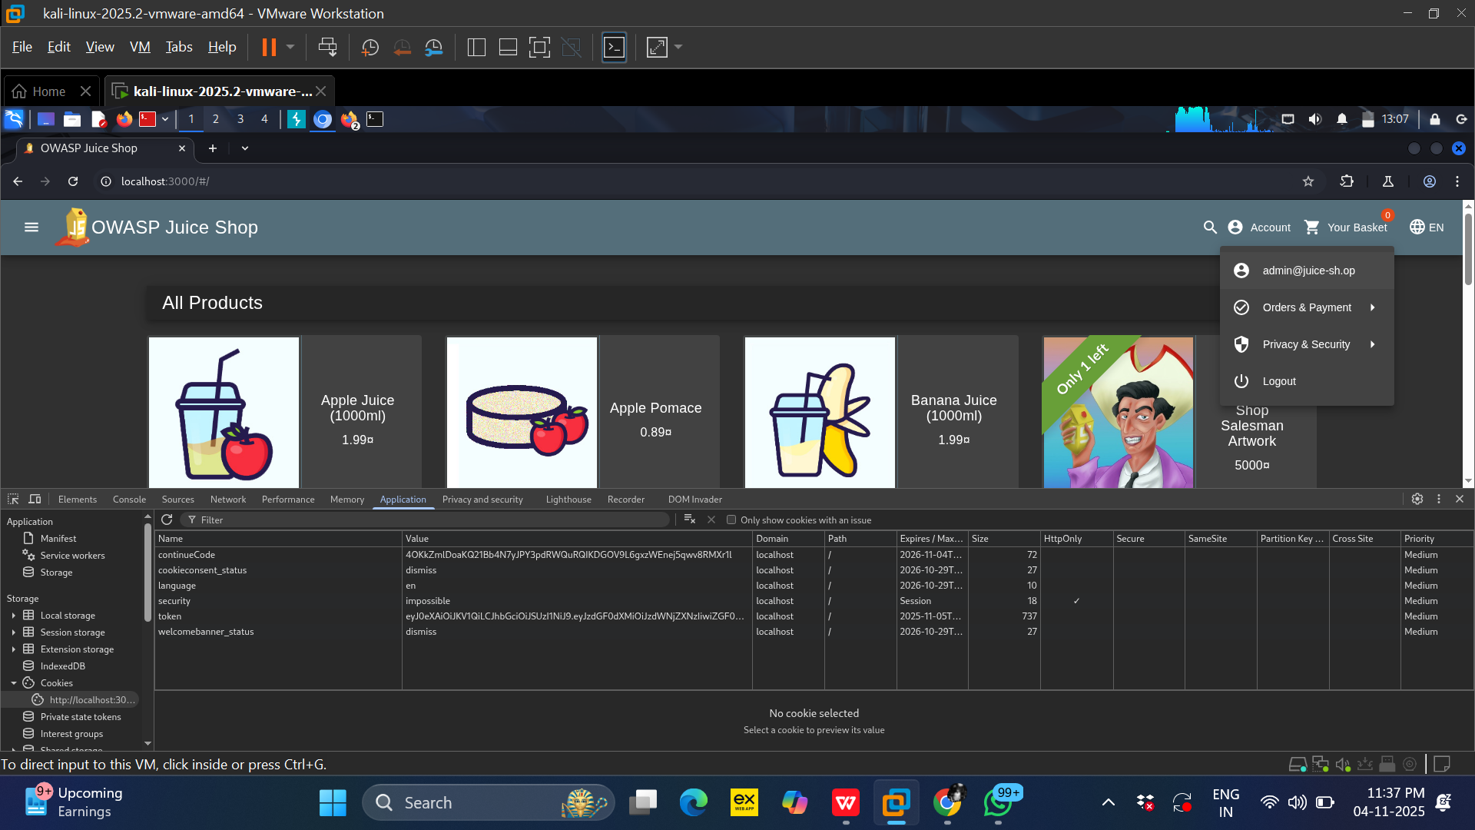
Step19:- The victim’s user ID, previously recorded, is now displayed in the attacker’s browser. This provides confirmation of the session hijack; the account name is visible near the search bar in Burp Suite’s browser

Slide 53
For Users:
Be cautious on public Wi-Fi: Always leave public Wi-Fi for more general activities such as reading e-mails or general browsing but not for any task that involves personal information like online banking.
Use strong passwords and Multi-Factor Authentication (MFA): Never use basic or easily guessable account information to secure your online profiles and where available, always activate two-factor authentication. It doubles the protection barrier.
email attachments Beware of phishing attacks: Some of these may entice the targeted Internet user to click on links with wrong addresses or open supposed email containing Trojan programs whose purpose is to steal the session ID
Log out of accounts: Thus, it is recommended never to forget to sign out of your accounts when you are done with them, particularly in public domains that are frequently accessed by other people.
Keep software updated: It is also important to ensure that your operating system, or any other software you use, for instance, web browser, is updated to latest version as this will contain known security issues that could be exploited by attackers.
Recommendations

Slide 54
For Developers and Organizations:
HTTPS Everywhere: Among different security measures, HTTPS must be put in practice on all web-pages. While HTTP transmits information in plaintext easily accessible to attackers, HTTPS ensures that information exchanges between the user's browser and web server are encrypted, and hence, makes it difficult for attackers to steal session IDs.
Secure cookies: To minimize access of cookies by an attacker, use secure cookies with HTTP Only attribute that would make the cookies inaccessible to scripts such as Java Script. This also reduces Cross-Site Scripting (XSS) attacks that are likely to have a potential of stealing session IDs.
Strong session management: Protected session management of user's accounts should be put into practice. It involves the factors such us avoiding the use of sequential numbers for session IDs, setting the right idle time-out for sessions, and destroying sessions after log out.
Regular security testing: Check and test the web applications for developing security holes that can be used by attackers for session hijacking.

Slide 55
Questions ?

Slide 56
Thank You!

